Slide 1










Greenhouse gas fluxes derived from regional measurement networks and atmospheric inversions: Results from the MCI and INFLUX experiments
GC41G-07
Kenneth Davis¹, Arlyn Andrews², Maria Cambaliza³, Scott Denning⁴, Liza Diaz¹, Kevin Gurney⁵, Thomas Lauvaux¹, Natasha Miles¹, Stephen Ogle⁴, Antonio Possolo⁶, Scott Richardson¹, Andrew Schuh⁴, Paul Shepson³, and Colm Sweeney², Jocelyn Turnbull², Tristram West⁷ and James Whetstone⁶
¹The Pennsylvania State University, ²NOAA ESRL, ³Purdue University, ⁴Colorado State University, ⁵Arizona State University, ⁶NIST, ⁷PNNL
“Toward a Global Greenhouse Gas Information System,” AGU Fall Meeting, San Francisco, CA, 16 December, 2010
NACP

Slide 2
Learn by doing
What is needed to estimate regional CO₂ fluxes using atmospheric data?
The MCI and INFLUX are experiments aimed at addressing this question experimentally.

Slide 3
Evolution of the MCI
1999 US Carbon Cycle Science Plan (Sarmiento and Wofsy) proposed regional atmospheric inversions.
2002 white paper by Pieter Tans proposed the U.S. midcontinent as a good experimental site – agricultural fluxes are known because of harvest/inventory data.
2006 Midcontinent Intensive (MCI) science plan (Ogle et al) spelled out the objectives of this contribution to the North American Carbon Program (NACP).
Field work, 2005-2009. Analyses are at hand!
The primary objective of the NACP MCI is to test of our ability to achieve convergence of “top-down” and “bottom-up” estimates of the terrestrial carbon balance of a large, sub-continental region.

Slide 4
INFLUX
Indianapolis flux experiment: A field campaign with very similar objectives to the NACP MCI, but aimed at urban/anthropogenic carbon fluxes.

Slide 5
Experimental design
Dense, tower-based greenhouse gas measurement network
Relatively simple terrain and dense meteorological data
  These yield our best chances to derive robust flux estimates using atmospheric inversions.
Excellent “bottom-up” flux estimates from inventory methods
  This provides the test for the atmospheric inversion methodology.

Slide 6


Toolbox (used at Penn State)
Atmospheric transport model:
(WRF, 10km for the MCI)
(WRF, 2km for INFLUX)
Boundary conditions (CO2/met):
(Carbon Tracker and NOAA aircraft profiles,
NCEP meteorology)
Air Parcel
wind
wind
Air Parcel
Sources
Sinks
Air Parcel
Prior flux estimate:
(SiB-Crop for MCI)
(Hestia for INFLUX)
Sample
Sample
Network of tower-based GHG sensors:
(9 sites with CO₂ for the MCI)
(~11 sites with CO₂, CH₄, CO and ¹⁴CO₂ for INFLUX)

Slide 7
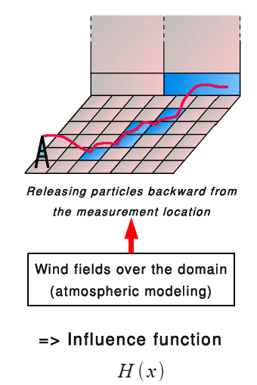
Toolbox, continued
Lagragian Particle Dispersion Model (LPDM, Uliasz).
  Determines “influence function” – the areas that contribute to GHG concentrations at measurement points.
Independent data for evaluation of our results.
  Agricultural inventory, flux towers and some aircraft data for the MCI
  Fossil fuel inventory, (flux towers?) and abundant in situ aircraft data for INFLUX

Slide 8
Inversion method
Simulate atmospheric transport.
Run LPDM to determine influence functions
Convolute influence functions with prior flux estimates to predict CO₂ at observation points
Compare modeled and observed CO₂ and minimize the difference by adjusting the fluxes and boundary conditions.

Slide 9
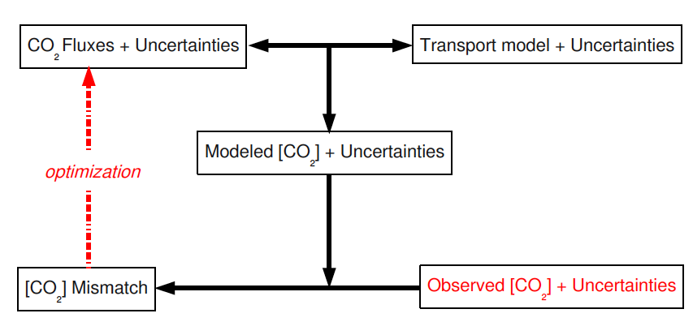
Inversion method (graphic)
Estimated together
Enhance uncertainty assessment by experimenting with the prior and the uncertainty estimates (model-data, prior) and examining the impact on the derived fluxes.

Slide 10
Results from the NACP MCI

Slide 11
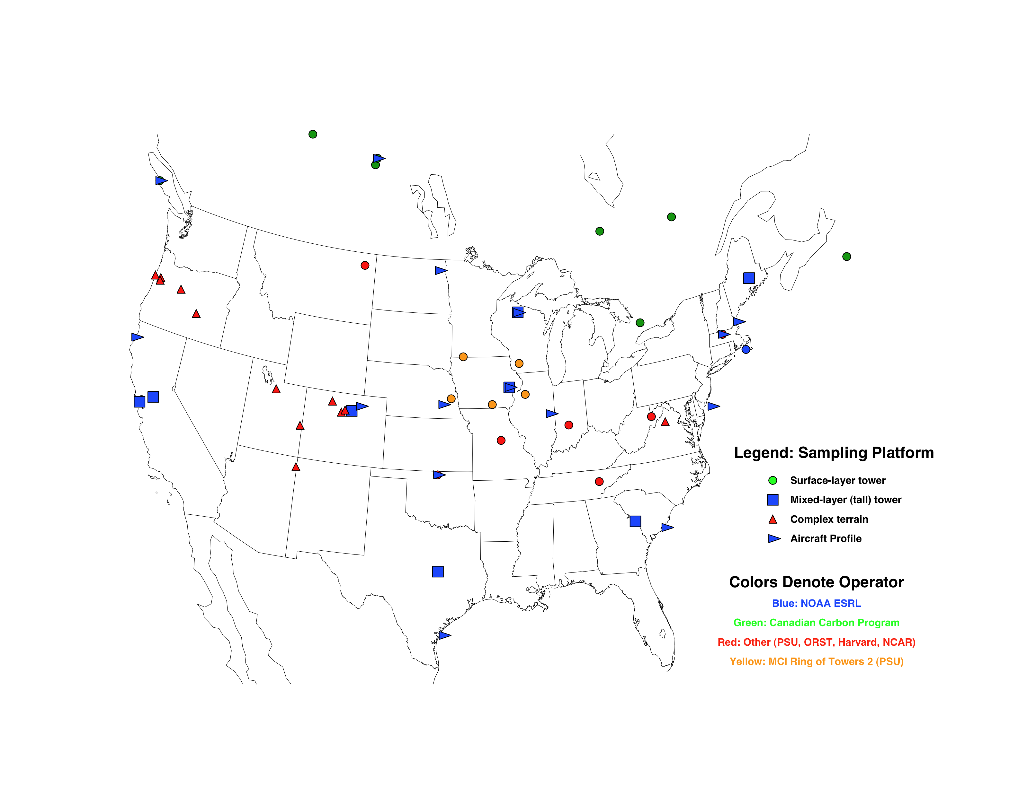
CO₂ Concentration Network: 2008
INFLUX, 2010-2012
Midcontinent intensive, 2007-2009
Gulf coast intensive, 2013-2014

Slide 12
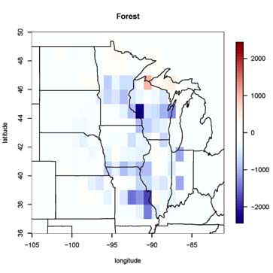
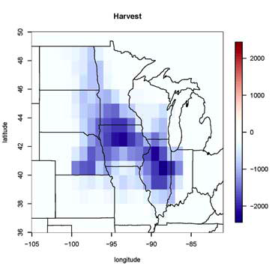
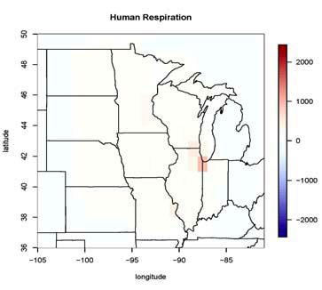
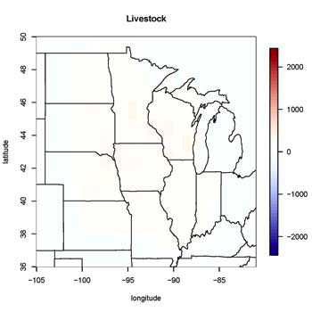
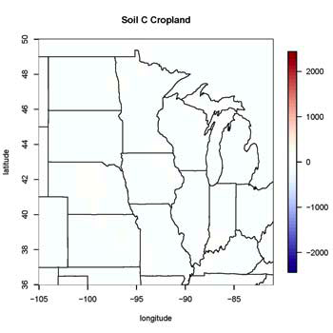
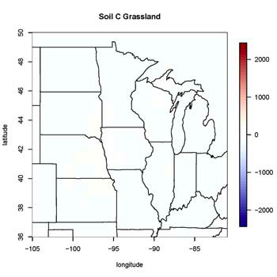
MCI inventory estimates
West, Ogle, Gurney and colleagues

Slide 13
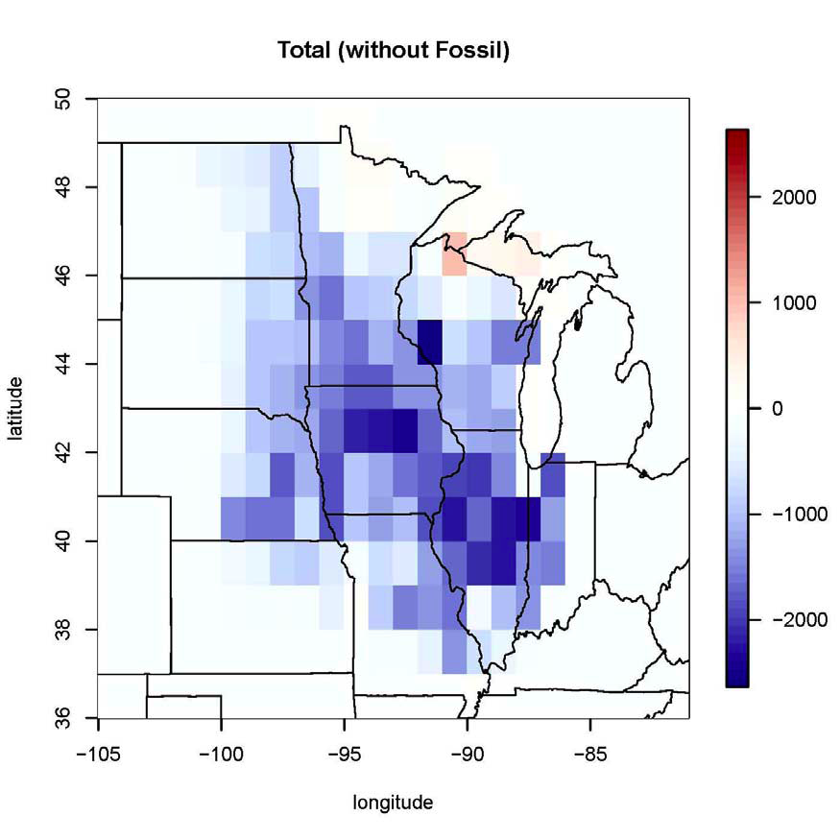
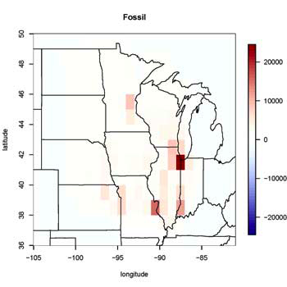
MCI inventory estimates
West, Ogle, Gurney and colleagues
West et al, submitted.
Schuh et al, B51L-05

Slide 14
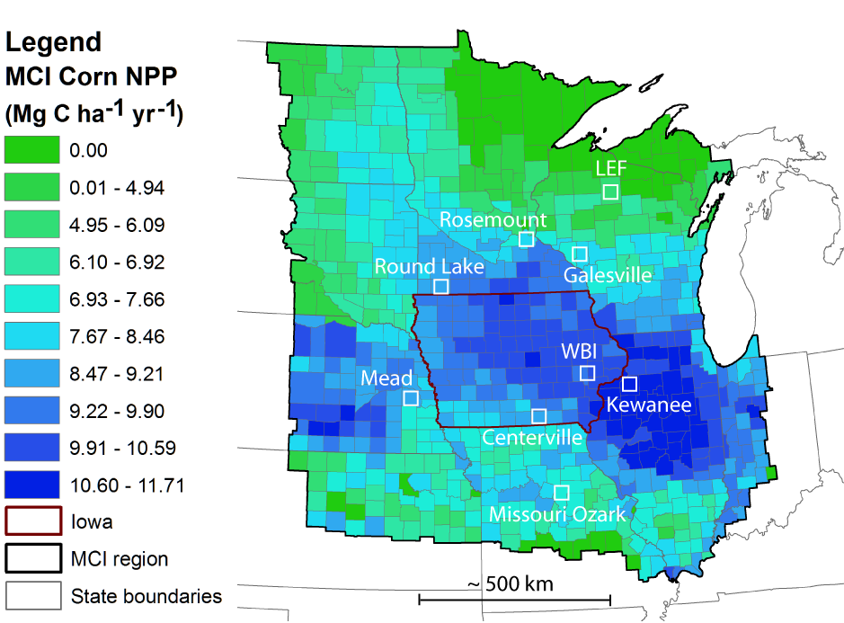
MCI Tower-Based CO2 Observational Network
Corn-dominated sites
Aircraft profile sites, flux towers omitted for clarity.

Slide 15
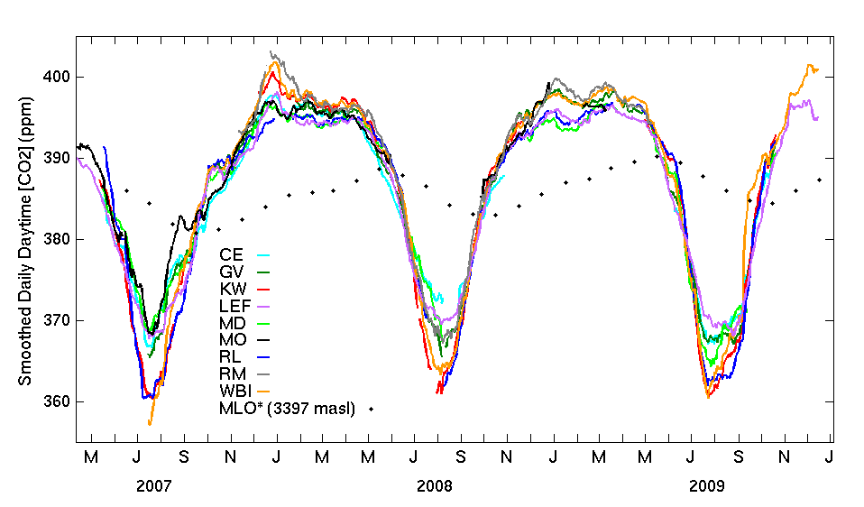
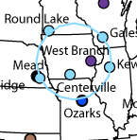
MCI 31 day running mean daily daytime average CO2
Mauna Loa
Large variance in seasonal drawdown, despite being separated by ~ 500-800 km
2 groups: 33-39 ppm drawdown and 24 – 29 ppm drawdown (difference of about 10 ppm)
Miles et al, in preparation

Slide 16
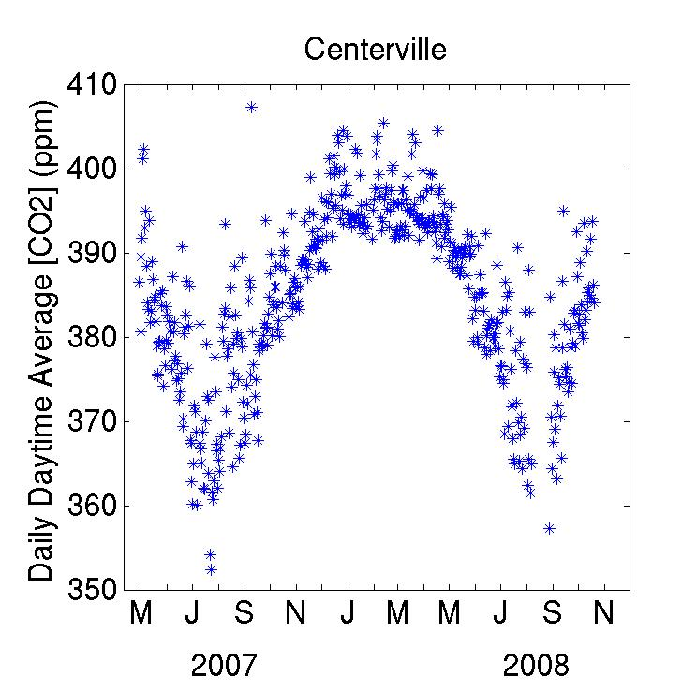
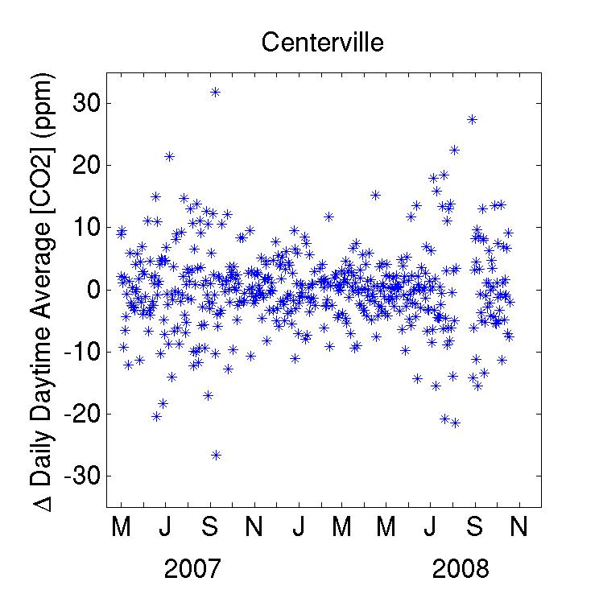
Synoptic variability in boundary-layer CO2 mixing ratios: Daily daytime averages
Daily differences from site to site as large at 60 ppm.
Miles et al, in preparation

Slide 17
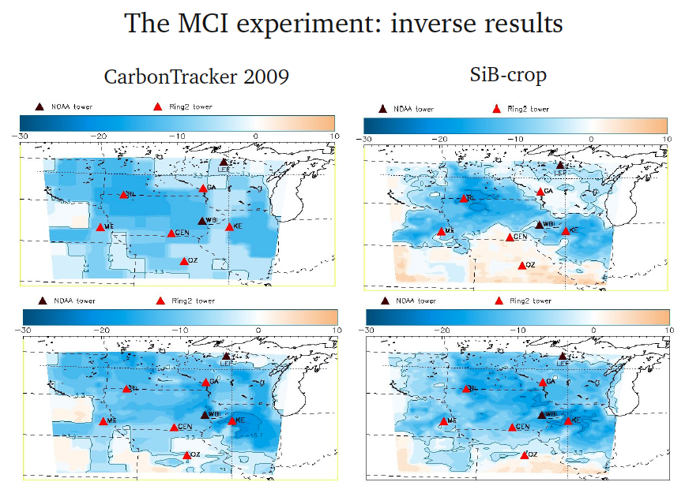
Prior flux estimate
Posterior flux estimate
Units are TgC/degree², Jun-Dec07
Lauvaux et al, in preparation, A

Slide 18
Spatial pattern of NEE is not overly sensitive to the prior.
Prior flux estimate
Posterior flux estimate
Units are TgC/degree², Jun-Dec07
Lauvaux et al, in preparation, A

Slide 19
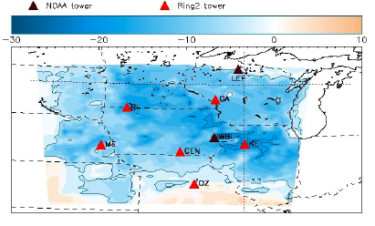
Comparison to inventory
PSU SiB-crop inversion
Inventory estimate
Spatial patterns are similar.
Integrated net fluxes are similar.
Ogle et al, in prep

Slide 20
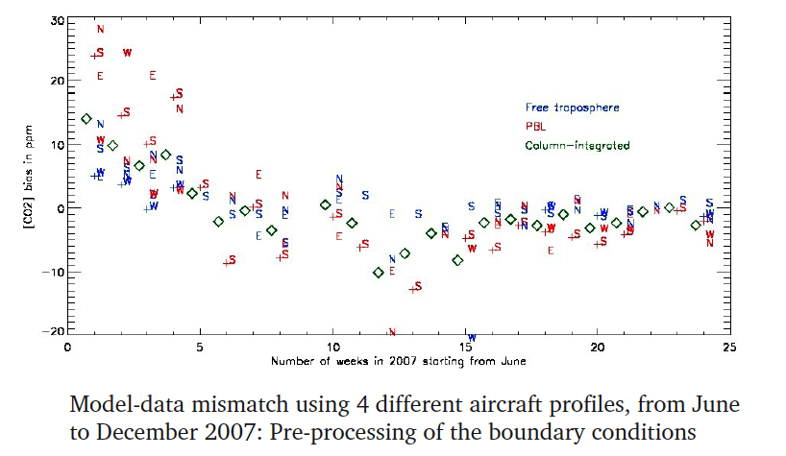
CO2 boundary condition adjustment
CT vs. NOAA aircraft profiles
Lauvaux et al, in preparation, A

Slide 21
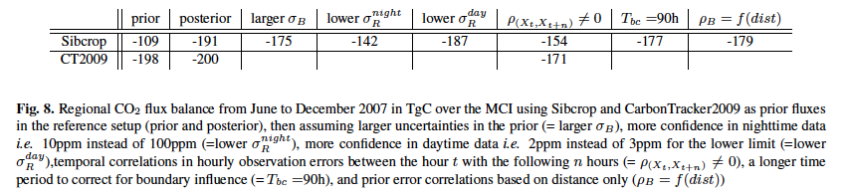
Regionally and time integrated C flux uncertainty
assessment
Experiments with the PSU inversion include varying the:
- prior flux
- prior flux uncertainty (magnitude and spatial correlation)
- model-data error (magnitude and temporal correlation)
- boundary condition temporal persistence.
Net flux estimate is fairly robust to the assumptions made in the inversion.
Lauvaux et al, in preparation, A

Slide 22
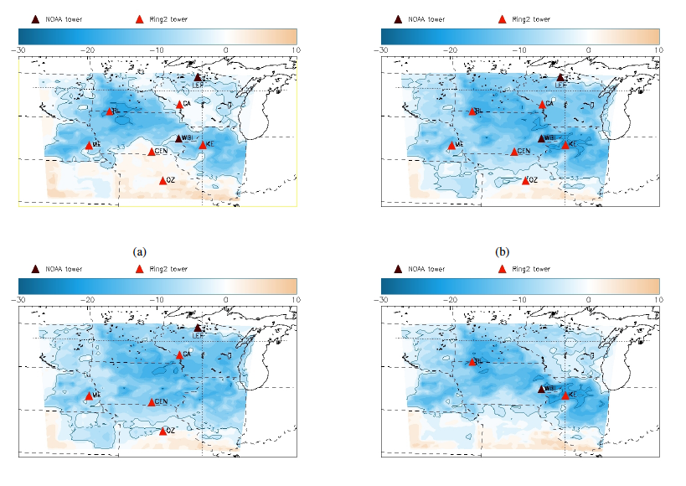
Impact of observational network:
Tower removal experiments
Prior flux
Posterior flux
Regional integral is fairly robust to tower removal.
Spatial patterns are quite sensitive to tower removal.
Posterior without “corn” sites
Posterior with only “corn” sites
Lauvaux et al, in prep, B

Slide 23
No explicit assessment yet of the impact of atmospheric transport uncertainty, save for comparison of CSU (RAMS), CT (TM5) and PSU (WRF) inversions.
Schuh et al, in prep; B51L-05
Diaz et al., in prep.

Slide 24
CO₂ Concentration Network: 2008
INFLUX, 2010-2012
Midcontinent intensive, 2007-2009
Gulf coast intensive, 2013-2014

Slide 25
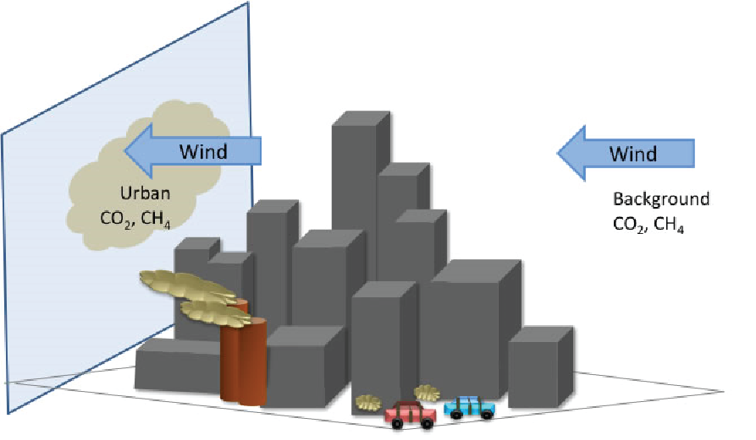
INFLUX (Indianapolis FLUX)
Project Goals:
• Develop improved approach for measurement of area-wide greenhouse gas emission fluxes within the urban area
• Compare top-down emission estimates from aircraft and tower-based measurements with bottom-up emission estimates from inventory methods
• Quantify uncertainties in the two approaches
Notes:
Present primarily plans as the experiment is just beginning.

Slide 26

Why Indianapolis?
Medium-sized city, with fossil fuel CO2 emissions of ~3.4 MtC yr⁻¹
Located far from other metropolitan areas, so the signal from Indianapolis can be isolated with relative ease
Flat terrain, making the meteorology relatively simple
1
View of Indianapolis from the White River
(photo by Jean Williams)

Slide 27
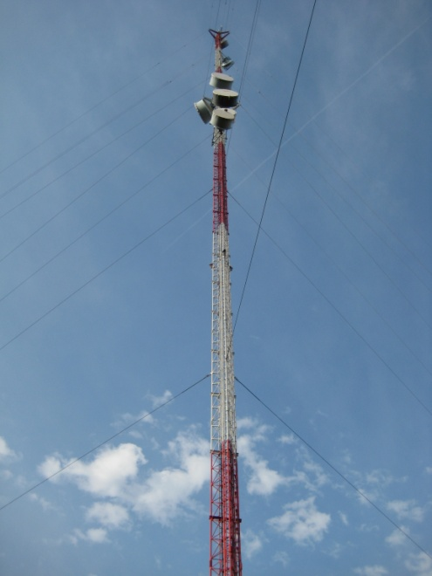
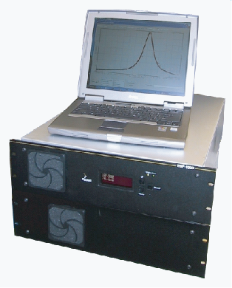

Tower-based measurements: continuous
Current: continuous measurements of CO2 at two sites
Planned
  Two sites measuring CO2/CO/CH4
  Three sites measuring CO2/CO
  Three sites measuring CO2/CH4
  Four sites measuring CO2

Slide 28
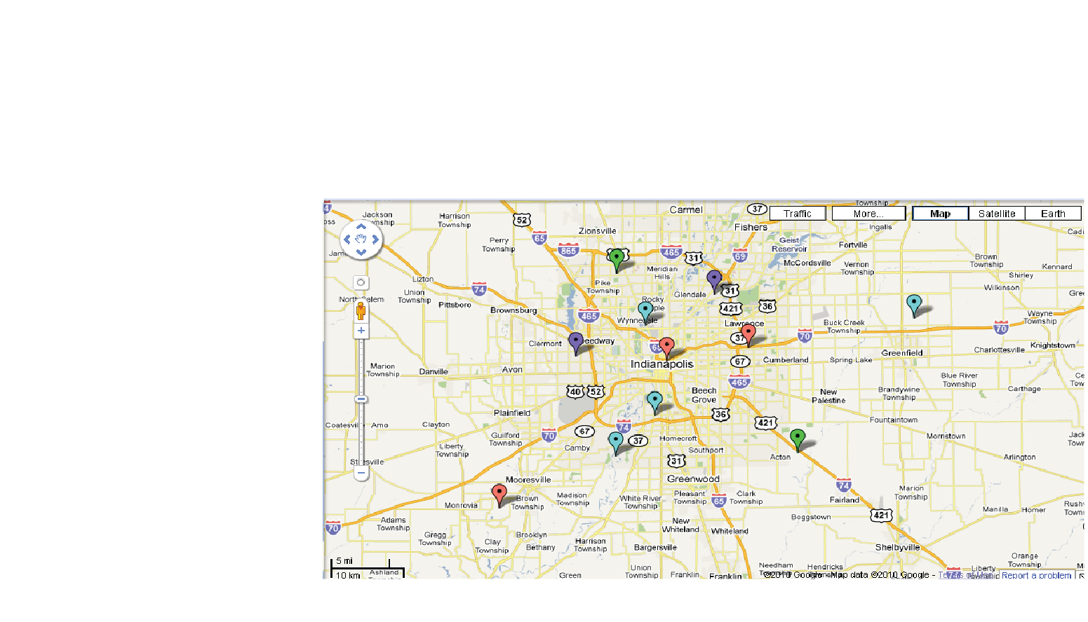
Tower locations
Sites 1 and 2 are currently measuring CO2.
Sites 3 through 12 are planned, with tentative locations shown.
Mixture of continuous CO2, CH4 and CO sensors, and flask 14CO2 data.
2
1
1

Slide 29
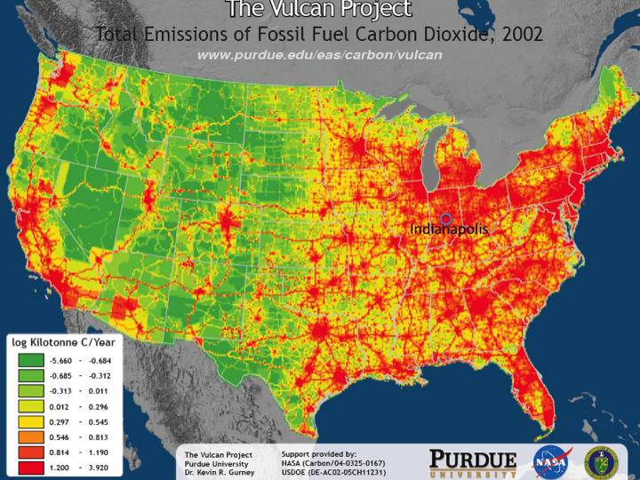

Slide 30
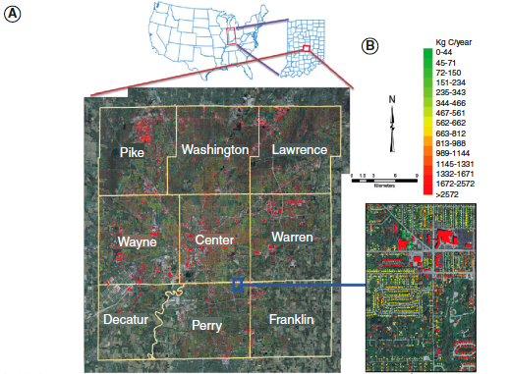
Hestia: A downscaled inventory derived from Vulcan
Y. Zhou and K. Gurney, A new methodology for quantifying on-site residential and commercial fossil fuel CO2 emissions at the building spatial scale and hourly time scale, Carbon Management (2010) 1(1), 45–56.

Slide 31
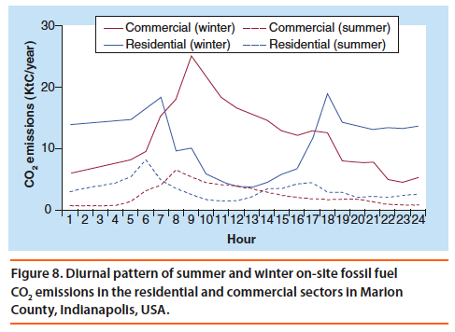
Hestia: Hourly, building level resolution of emissions

Slide 32
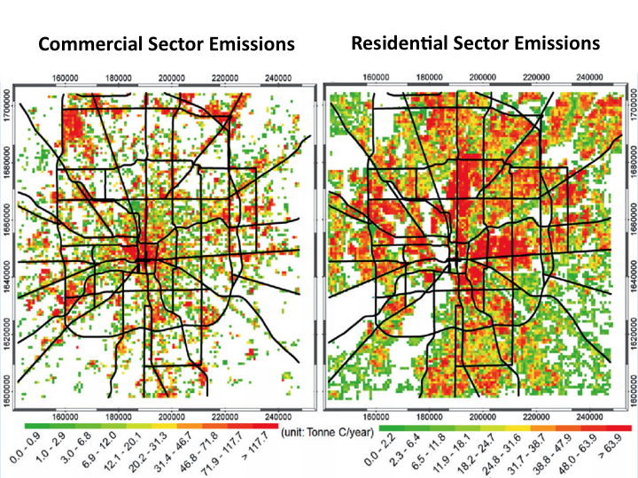
Hestia Annual Fluxes for Indianapolis

Slide 33
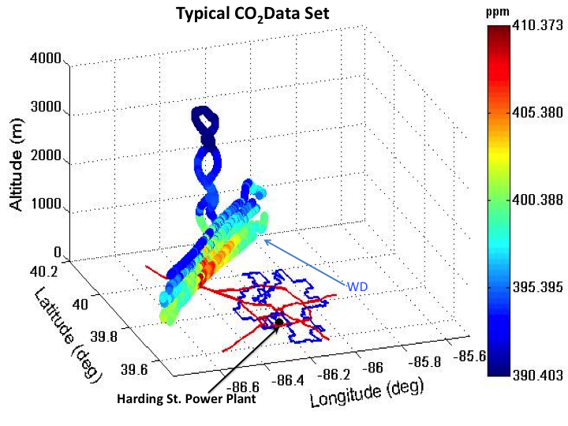
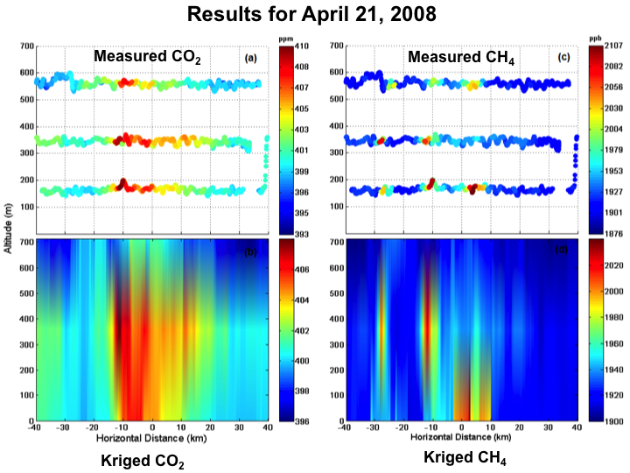
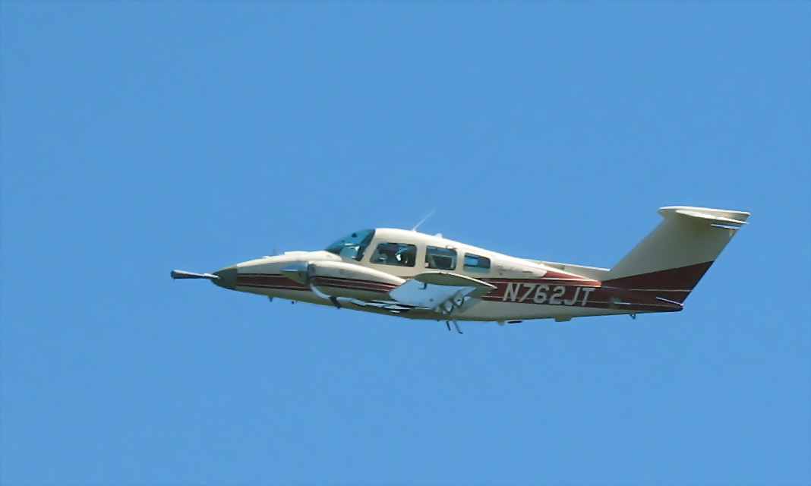
Purdue airborne sampling
(budget flux estimates, source ID, transport test)
Mays, K. L., P. B. Shepson, B. H. Stirm, A. Karion, C. Sweeney, and K. R. Gurney, 2009. Aircraft-Based Measurements of the Carbon Footprint of Indianapolis, Environ. Sci. Technol., 43, 7816-7823

Slide 34
Calculation of recently added fossil fuel CO₂ mixing ratio from observations of CO₂ and Δ¹⁴CO₂
C
=
C
+
C
+
C
obs
bg
ff
r
C
Δ
=
C
Δ
+
C
Δ
+
C
Δ
obs
obs
bg
bg
ff
ff
r
r
C
(
Δ
-
Δ
)
C
(
Δ
-
Δ
)
C
=
obs
obs
bg
-
r
r
bg
ff
Δ
-
Δ
Δ
-
Δ
ff
bg
ff
bg
{(
)
}
(
14
C
)
Δ¹⁴CO₂=
C
sa
-1
x1000‰
(
14
C
)
C
std
BN[x]
std=1.176x10⁻¹² ¹⁴C/C
Notes:
Notes from Jocelyn – I will summarize much more succinctly.
These equations calculate the “recently added” fossil fuel CO2 - ie what has been added in comparison to a background value, and for the Sacramento study, refer to the fossil fuel CO2 buildup in the boundary layer relative to the free troposphere. BG value used was the highest D14 seen in campaign, on 2/26 at 3000 meters. Seemed the cleanest sample;
C=CO₂, Δ = Δ¹⁴CO₂ obs=observed in sample, bg=background, ff=fossil fuel, r=heterotrophic respiration
The first two equations are combined to get the third one. The first term dominates, and quantifies the effect of adding 14C-free (-1000permil) fossil fuel CO2 to the atmosphere, decreasing D14CO2. In the current atmosphere, the effect is about -28permil change in D14CO2 for every 1ppm of fossil fuel CO2 added.
The second term is a small correction for the fact that D14CO2 of heterotrophic respiration is slightly higher than that in the current atmosphere. The correction is 0.2 ppm in winter and 0.5 ppm in summer.
The last equation is the definition of D14CO2. Ie a ratio of ratios - 14C/C of the sample, over that of a standard. The subscript BN[x] indicates that it is (1) corrected for Blank, (2) Normalized to a standard delta 13C value, (3) corrected for radioactive decay between the time of collection and the time of measurement.
The most important point here is the normalization correction, which means that any process that fractionates (e.g. photosynthesis) does not change D14CO2. Only disequilibrium processes change D14CO2. Over the land, this effectively means that only fossil fuel emissions and heterotrophic respiration need to be considered.

Slide 35
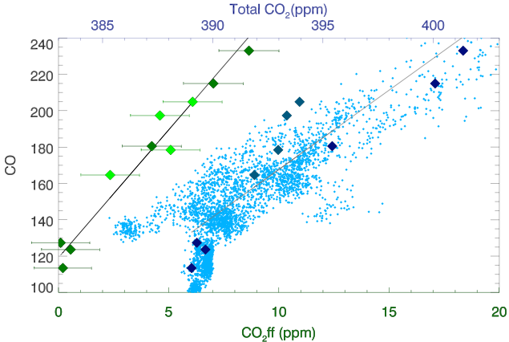
Emission ratios: CO:CO₂ff
14±2 ppb/ppm
20 ppb/ppm
9 ppb/ppm
7 ppb/ppm
Turnbull, J. C., Karion, A., Fischer, M. L., Faloona, I. C., Guilderson, T. P., Lehman, S. J., Miller, B. R., Miller, J. B., Montzka, S. A., Sherwood, T., Saripalli, S., Sweeney, C., and Tans, P. P.: Measurement of fossil fuel derived carbon dioxide and other anthropogenic trace gases above Sacramento, California in spring 2009, Atmospheric Chemistry and Physics Discussions, 10.5194/acpd-10-1-2010, 2010.
Notes:
If use CO2 enhancement instead of CO2ff, get very different answer for RCO - and bias is different for the two flights.
Large blue points – total CO2 vs CO (top axis). Small blue points are continuous (2 minute) measurements from SAC227. (No continuous CO in SAC306).
And that is because of biological CO2 – which apparently had a different sign for the two flights – I’ll show you more of that in a minute.

Slide 36
Conclusions
Regional C flux inverse estimates for the MCI appear to converge with inventory estimates.
Regional C flux inverse estimates for the MCI are fairly robust to assumptions.
Regional sums of NEE do not require a very dense observational network, but spatial patterns are highly sensitive to the network.
Differences remain across inversion systems (transport, structure of inversion).
Multi-species (fossil and bio CO2, CH4), high resolution (2 km) INFLUX inversions will address similar questions for an urban experiment.

