Slide 1
Global net land carbon sink: Results from the Multi-scale Synthesis and Terrestrial Model Intercomparison Project (MsTMIP)
http://nacp.ornl.gov/MsTMIP.shtml
December 9, 2013
AGU Fall Meeting, San Francisco
Deborah N Huntzinger (deborah.huntzinger@nau.edu), Christopher R. Schwalm, Anna M. Michalak, Robert B. Cook, Andrew R. Jacobson, Kevin Schaefer, Yaxing Wei, and MsTMIP modeling teams.

Slide 2
Acknowledgements
Funding:
NASA Terrestrial Ecology Grant# NNX10AG01A
Modeling and Synthesis Thematic Data Center at Oak Ridge National Laboratory (http://nacp.ornl.gov), with funding through NASA Terrestrial Ecology Grant # NNH10AN68I
MsTMIP Modeling Team Participants (team leads):

Slide 3
Outline
Examine estimates of global net land carbon uptake from MsTMIP model ensemble.
Evaluate the range in MsTMIP model estimates of net land sink
Compare MsTMIP model estimates of net land sink against independent estimate from Global Carbon Project (GCP)
Evaluate the sensitivity of simulated net land uptake to different drivers

Slide 4
Multi-scale Synthesis & Terrestrial Model Intercomparison Project (MsTMIP): Global Simulations
Global (0.5° by 0.5°)
Standardized environmental input data
Climate, land cover & land-use/land-cover change history, phenology, atmospheric CO₂, nitrogen deposition rates, soil, C3/C4 grass, major crops
Initial results from 12 different TBMs (~20 participating in MsTMIP)
110-year simulation period (1901-2010)
5 different global simulations to assess sensitivity to different forcing factors
Huntzinger et al., (in press) The North American Carbon Program Multi-scale synthesis and Terrestrial Model Intercomparison Project – Part 1: Overview and experimental design, Geoscientific Model Development
Wei et al., (in review) The North American Carbon Program Multi-scale Synthesis and Terrestrial Model Intercomparison Project – Part 2: Environmental driver data, Geoscientific Model Development Discussions

Slide 5
MsTMIP Simulations: Global
Reference simulations → spin-up run out to 2010
Order | Domain | Sim | Climate | LULCC | Atm. CO₂ | Nitrogen
1 | Global | RG1 | Constant | Constant | Constant | Constant
2 |  | SG1 | Time-varying
3 |  | SG2 |  | Time-varying
4 |  | SG3 |  |  | Time-varying
5 |  | BG1 |  |  |  | Time-varying
Sensitivity simulations → turn one variable component on at a time to systematically test the impact of climate variability, CO₂ fertilization, nitrogen limitation, and land cover / land-use change on carbon exchange.
Changing climate, land-use, land-cover, CO₂ concentrations, nitrogen deposition rates
1801
1901
1980
2010
Start with steady-state initial conditions
Start monthly output
Start 3-hourly output
Stop

Slide 6
MsTMIP Simulations: Global
Model | RG1 | SG1 | SG2 | SG3 | BG1
Biome-BGC | X | X |  |  | X
CLASS-CTEM-N+ | X
CLM | X | X | X | X | X
CLM4-VIC | X | X | X | X | X
DLEM | X | X | X | X | X
GTEC | X | X | X | X
LPJ-wsl | X | X | X | X
ORCHIDEE-LSCE | X | X | X | X
SiB3-JPL | X | X
SiB-CASA | X
VEGAS | X | X | X | X
VISIT | X | X | X | X
Order | Domain | Sim | Climate | LULCC | Atm. CO₂ | Nitrogen
1 | Global | RG1 | Constant | Constant | Constant | Constant
2 |  | SG1 | Time-varying
3 |  | SG2 |  | Time-varying
4 |  | SG3 |  |  | Time-varying
5 |  | BG1 |  |  |  | Time-varying
MsTMIP model “best estimate” either SG3 or BG1 depending on whether model can handle time-varying nitrogen deposition.
MsTMIP “best estimate” used when comparing models against other independent estimates.

Slide 7
MsTMIP Net Land Sink
GPP
AutoResp
HeteroResp
Biogenic CH₄ flux
Pyrogenic Flux = CO₂ emissions, CH₄ emissions, CO emissions
Product Flux = Harvest removals (Crop, Wood), CO₂ emissions, CH₄ emissions
Aquatic Flux = Lateral transfer, CO₂ evasion, CH₄ evasion
NEE
NEE = -NEP + Fire_CO₂ + Product_CO₂ + Aquatic_CO₂
From Dan Hayes (ORNL)
Also see: Hayes, D. J., and D. P. Turner, EOS, 93(41), 2012.
Notes:
Net land sink estimates from participating MsTMIP models is derived from model estimates of Net Ecosystem Exchange (NEE).
As defined by the MsTMIP protocol, NEE not only equals the product of Ecosystem Respiration minus Gross Primary Productivity, but also other CO2 emissions returned to the atmosphere from fire, product emissions and aquatic emissions. Not all MsTMIP models consider all of these component fluxes.

Slide 8
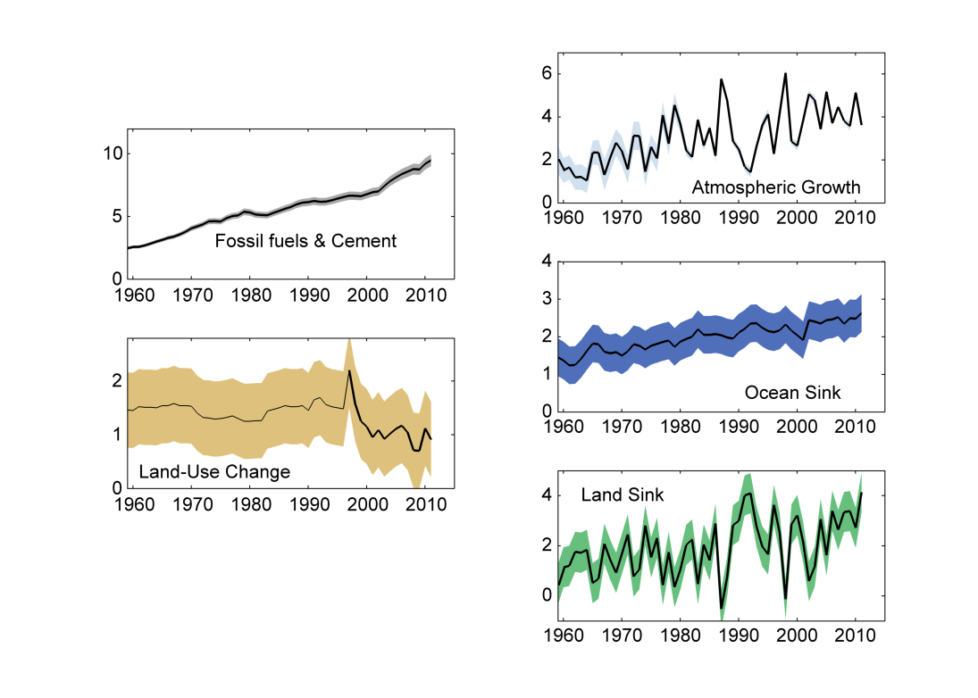
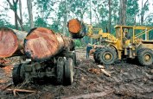
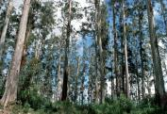
Changes in the global carbon budget over time from Global Carbon Project (GCP)
“Residual land sink”
-
“Residual land sink”
Source: Le Quéré et al. 2012; Global Carbon Project 2012
Sign convention: (+) net uptake, (-) net release
Notes:
Compare estimates of the net land sink from the MsTMIP ensemble of models to an independent estimate of flux taken from the Global Carbon Project’s Carbon Budget.
The GCP land sink is calculated as a residual or the difference the other terms in the mass balance budget.
The GCP carbon budget accounts for land-use change emissions separately. LULCC is a prescribed input driver for the MsTMIP simulations, thus the impacts of land-use change are accounted for explicitly in model estimates of NEE.

Slide 9
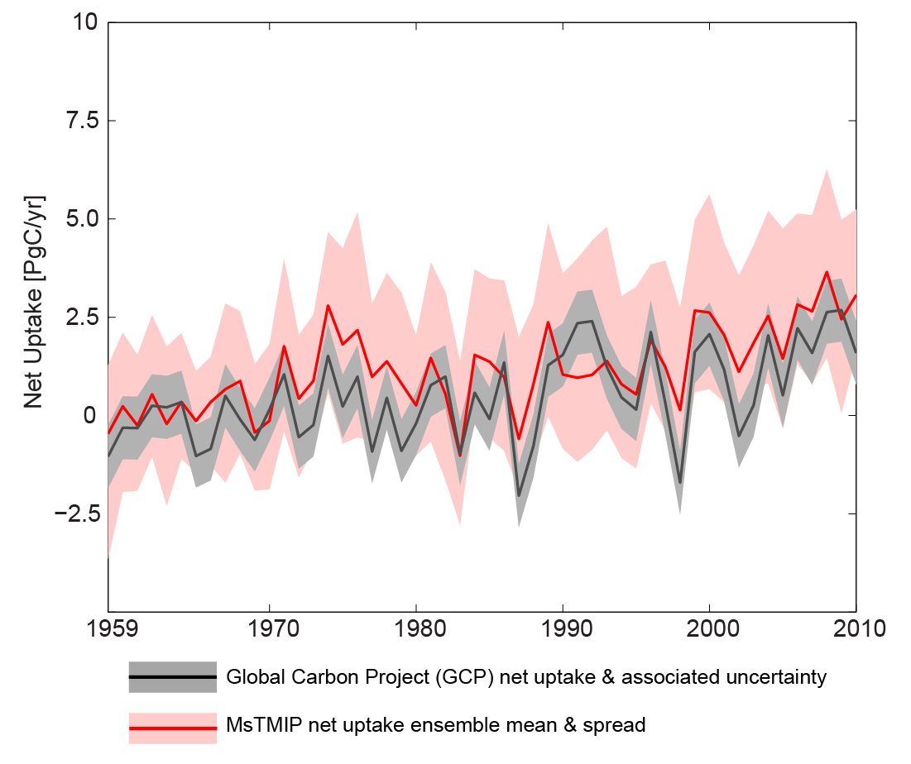
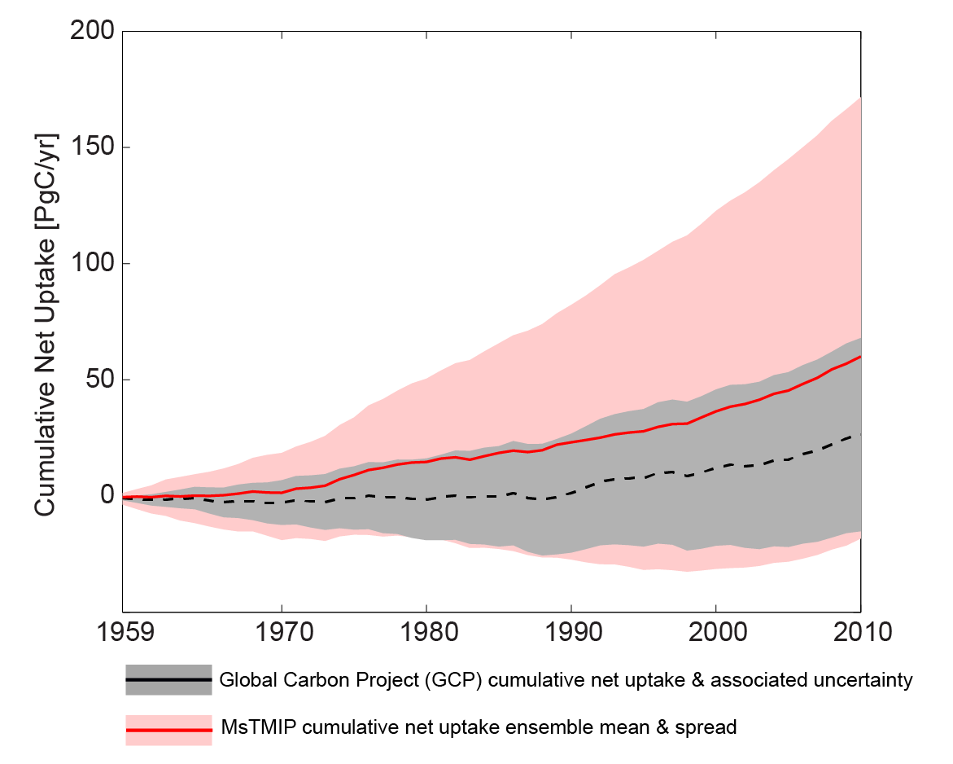
MsTMIP “best estimate” versus GCP estimate
“Residual land sink”
-
Sign convention:
(+) net uptake
(-) net release

Slide 10
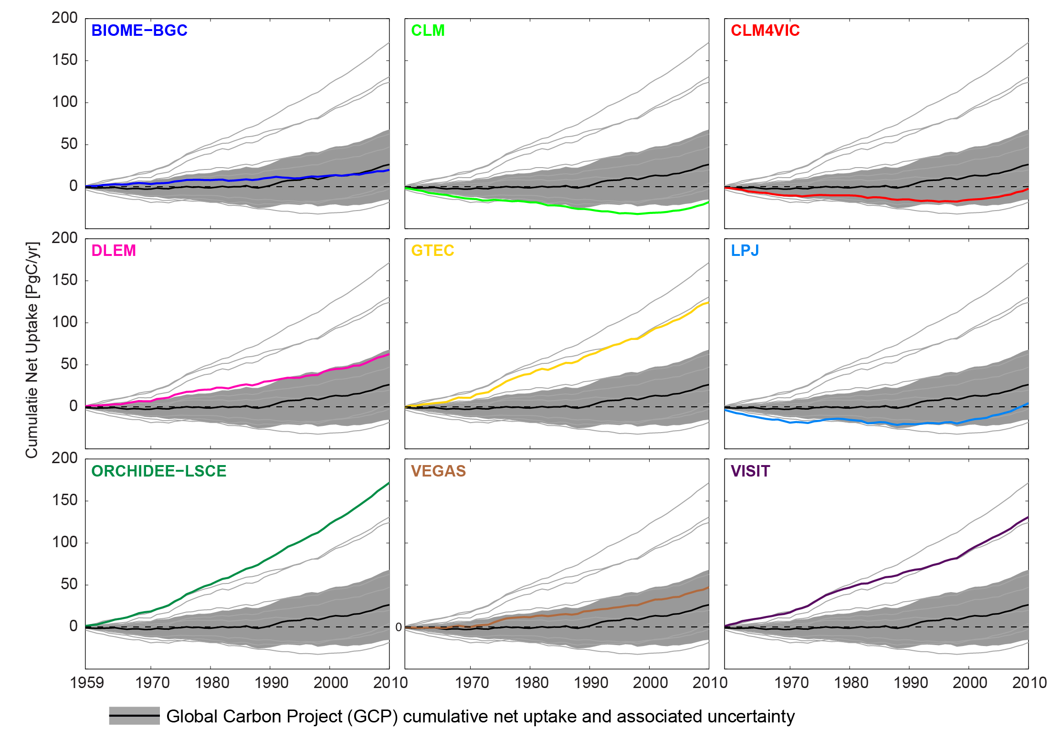
Mean estimate from MsTMIP ensemble shows slightly stronger sink than GCP product.
3 models predict a net land sink much greater than the GCP product.
For 3 models, over the last 50 years, the land surface has operated as net source of carbon.

Slide 11
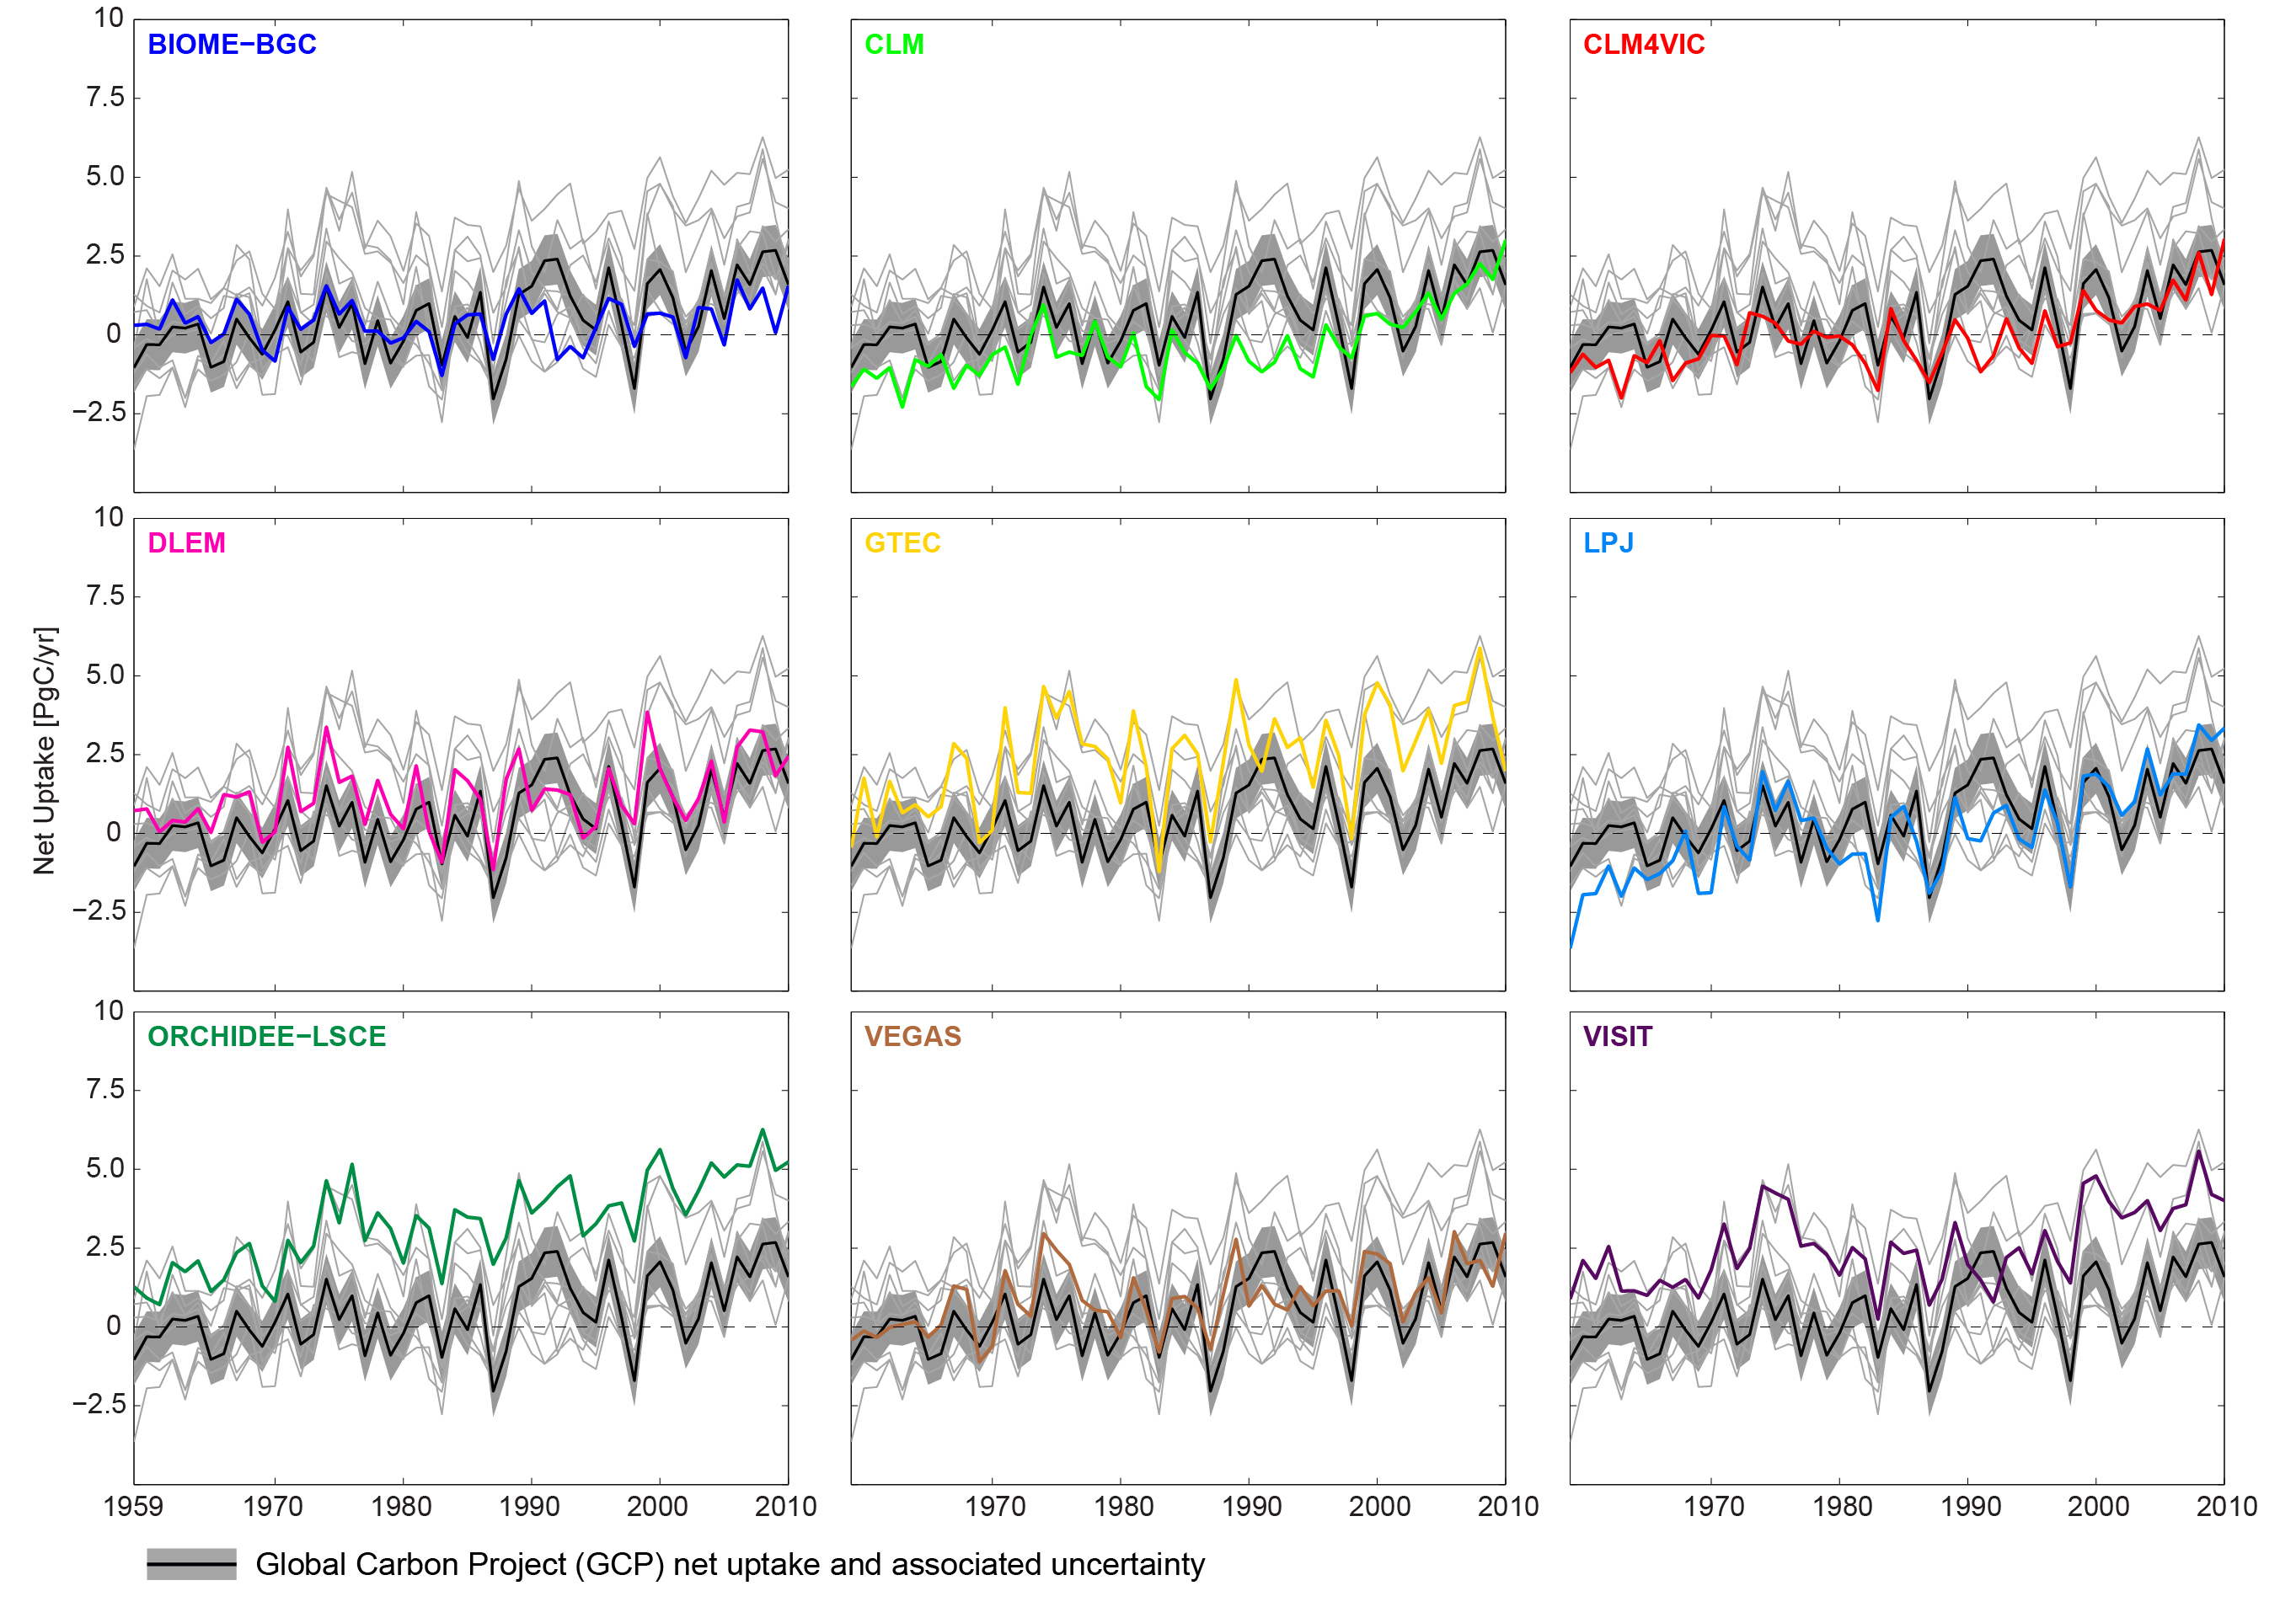
Post mid-1990s, however, all models show the land surface as a net sink of carbon.

Slide 12
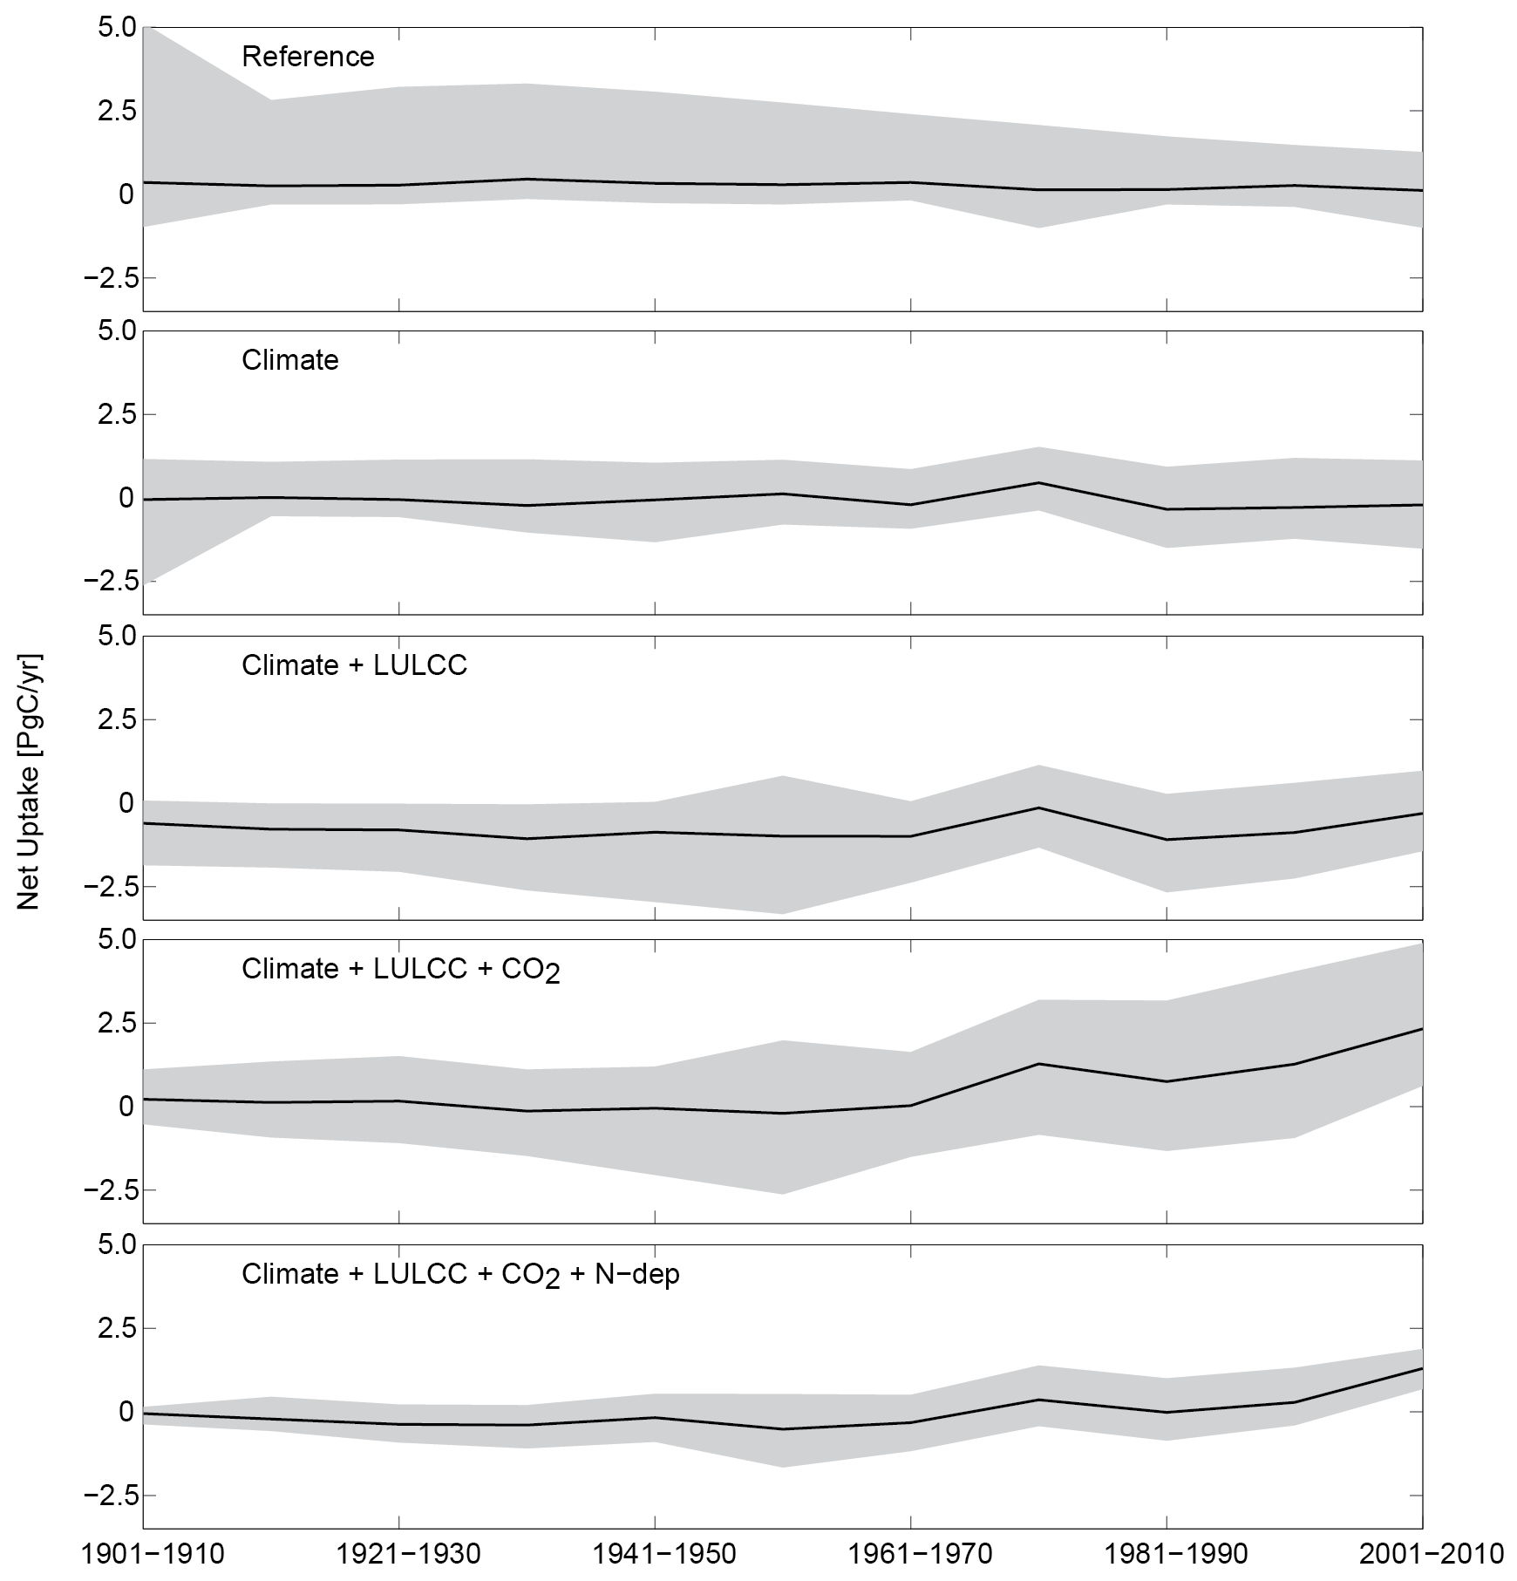
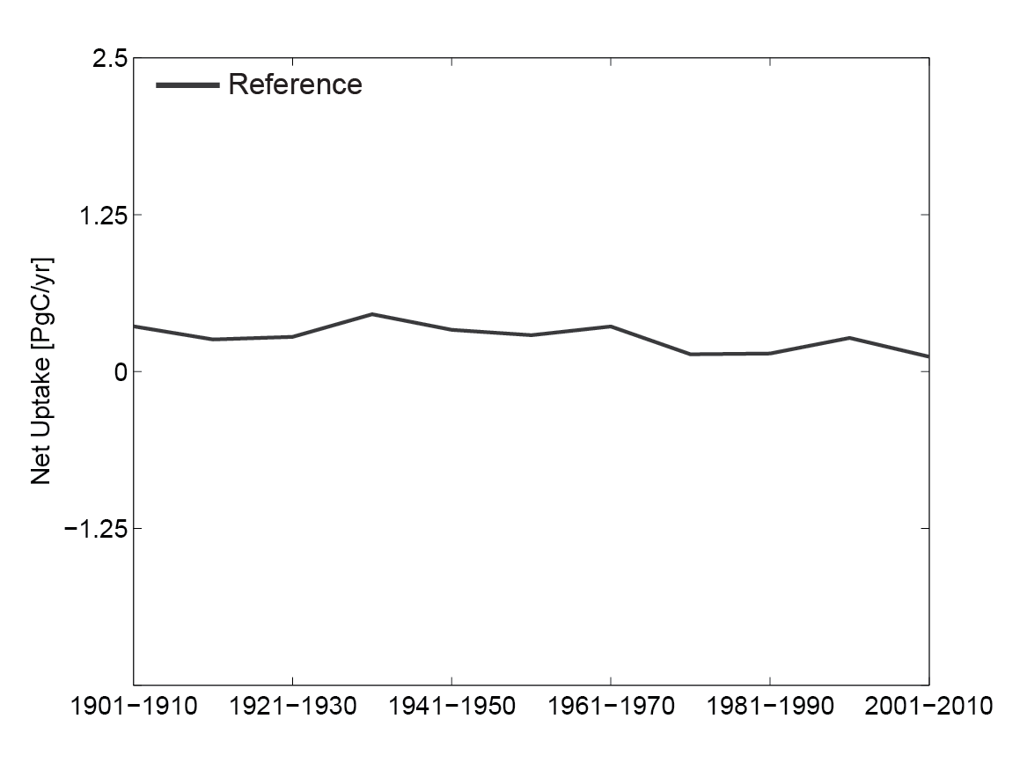
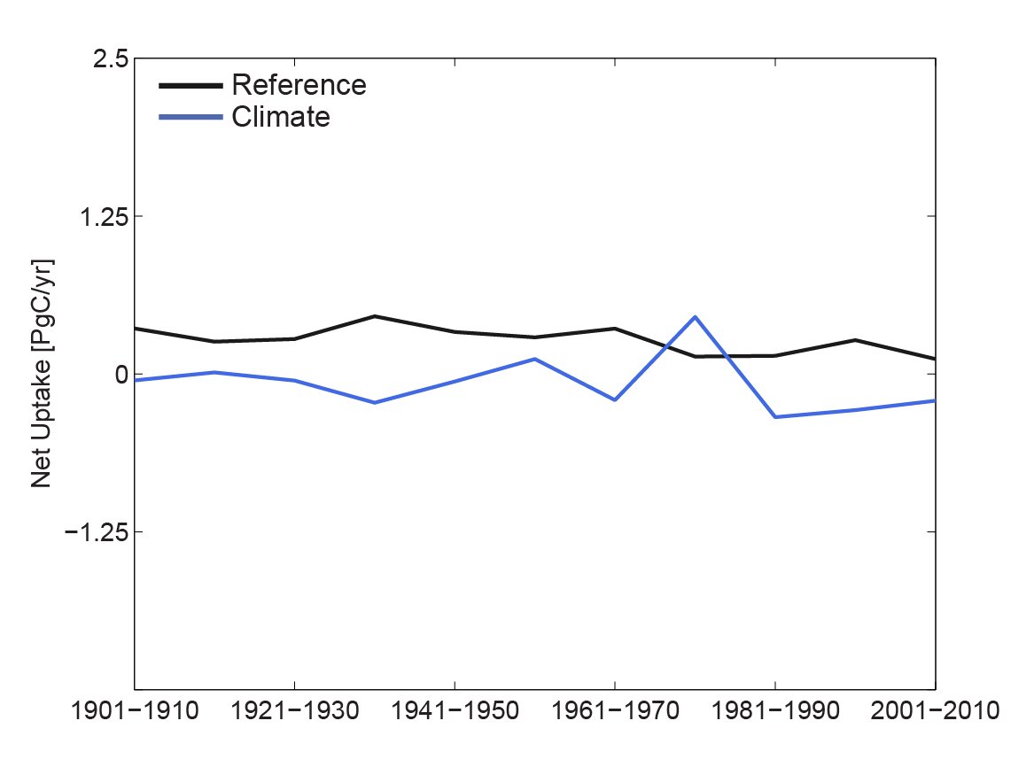
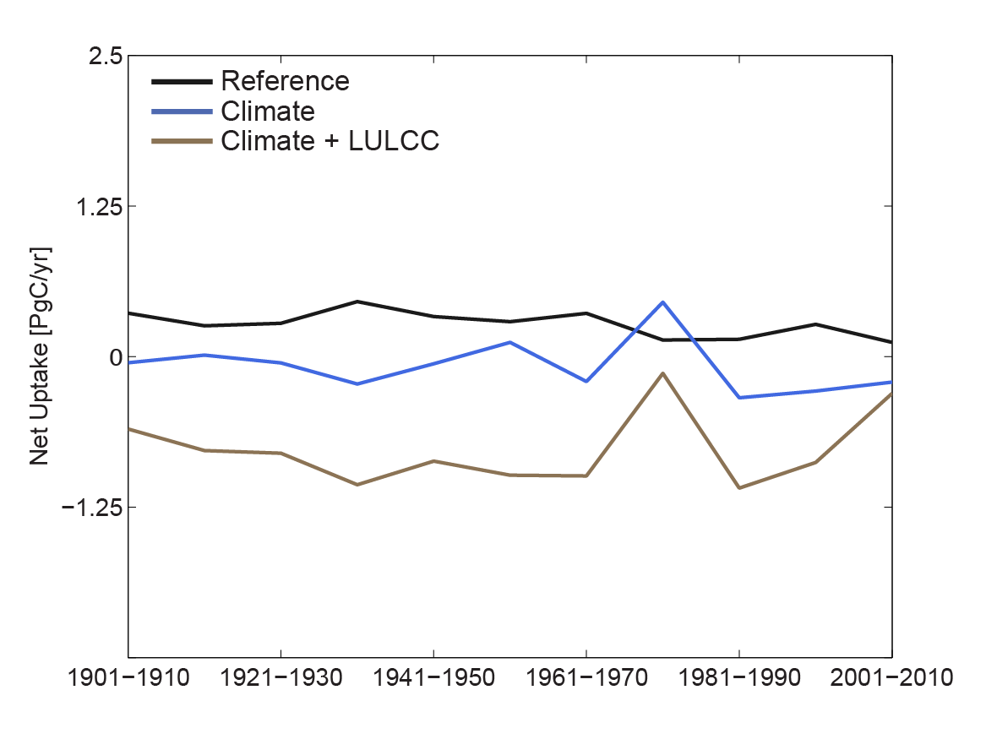
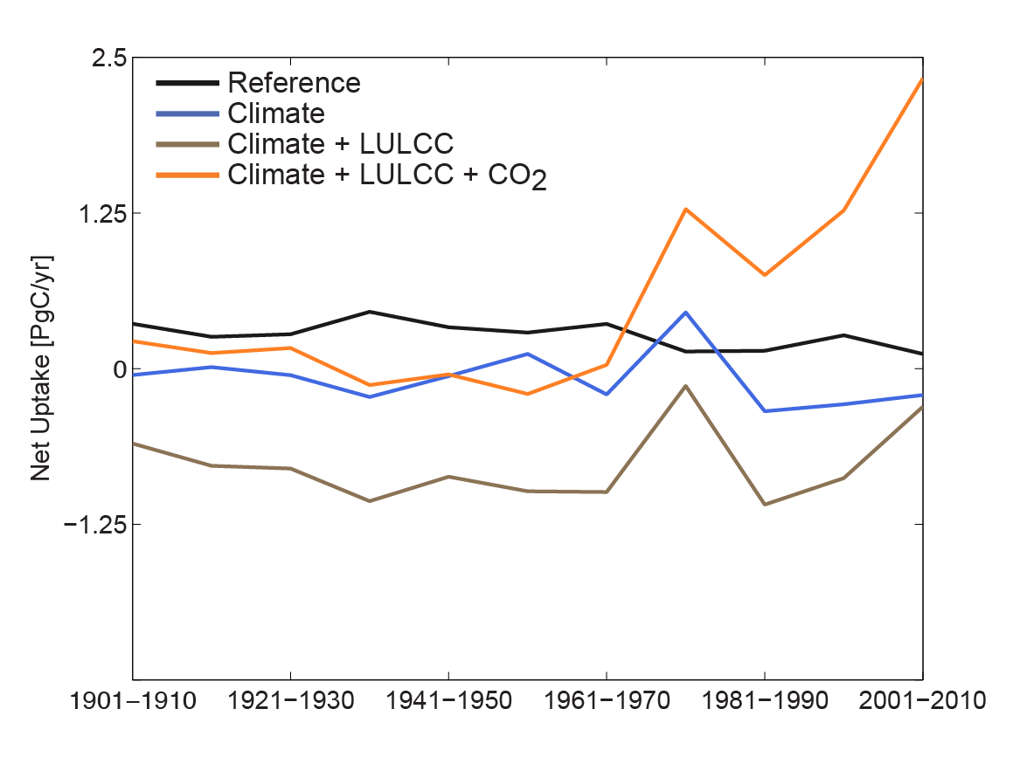
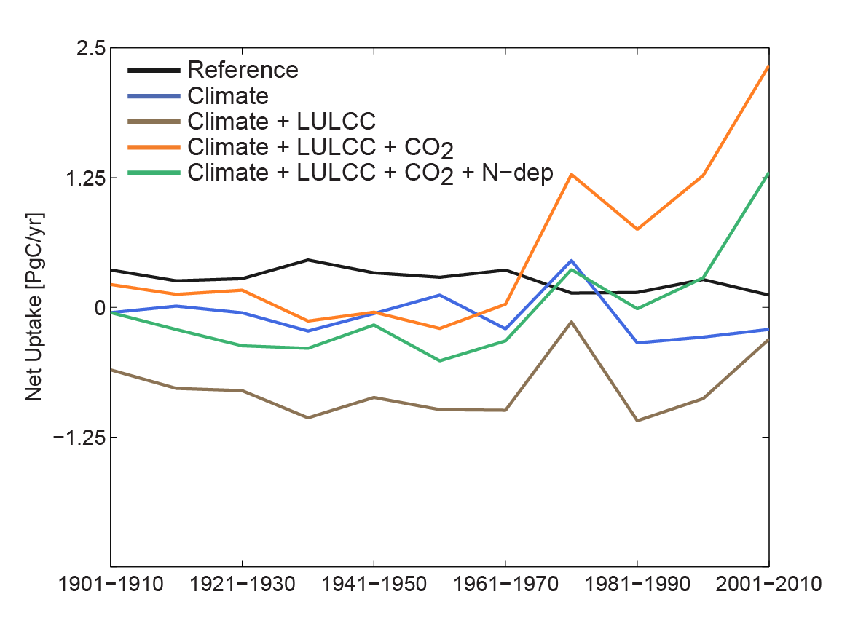
n = 12
Net land sink by simulation:
Adding in one time-varying driver at a time
n = 10
Model | RG1 | SG1 | SG2 | SG3 | BG1
Biome-BGC | X | X |  |  | X
CLASS-CTEM-N+ | X
CLM | X | X | X | X | X
CLM4-VIC | X | X | X | X | X
DLEM | X | X | X | X | X
GTEC | X | X | X | X
LPJ-wsl | X | X | X | X
ORCHIDEE-LSCE | X | X | X | X
SiB3-JPL | X | X
SiB-CASA | X
VEGAS | X | X | X | X
VISIT | X | X | X | X
n = 8
n = 8
n = 4
Notes:
Confounded by fact that N (number of models) is not constant.

Slide 13
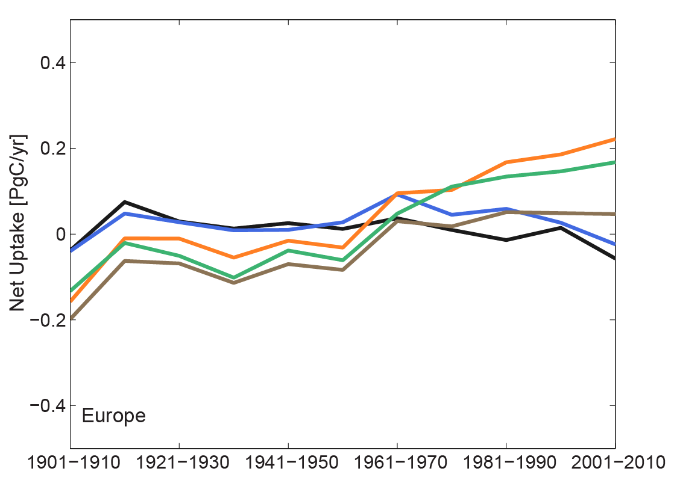
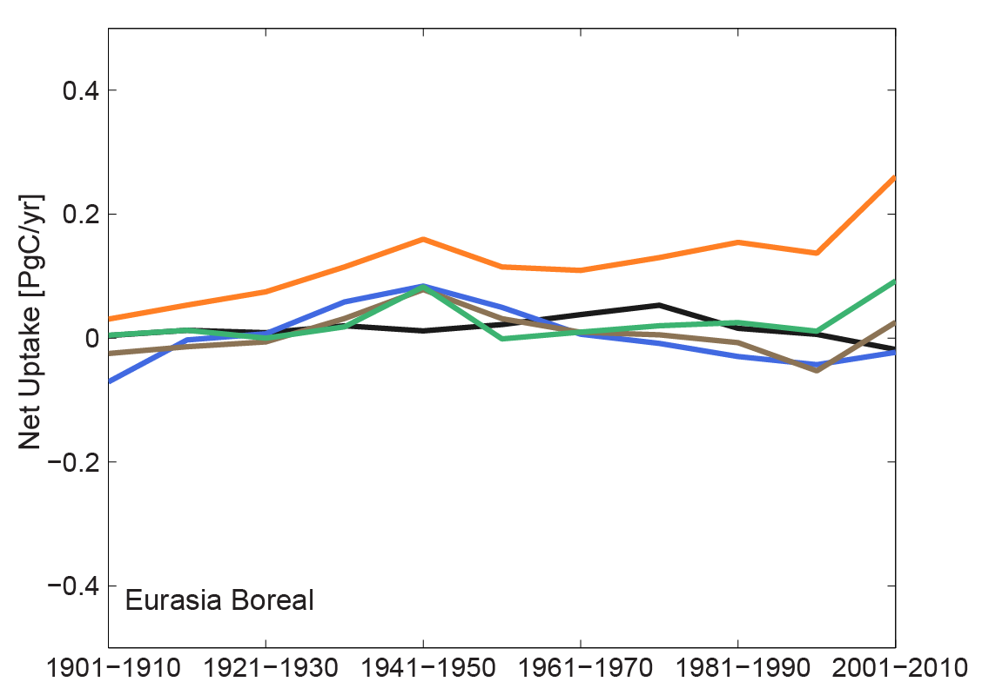
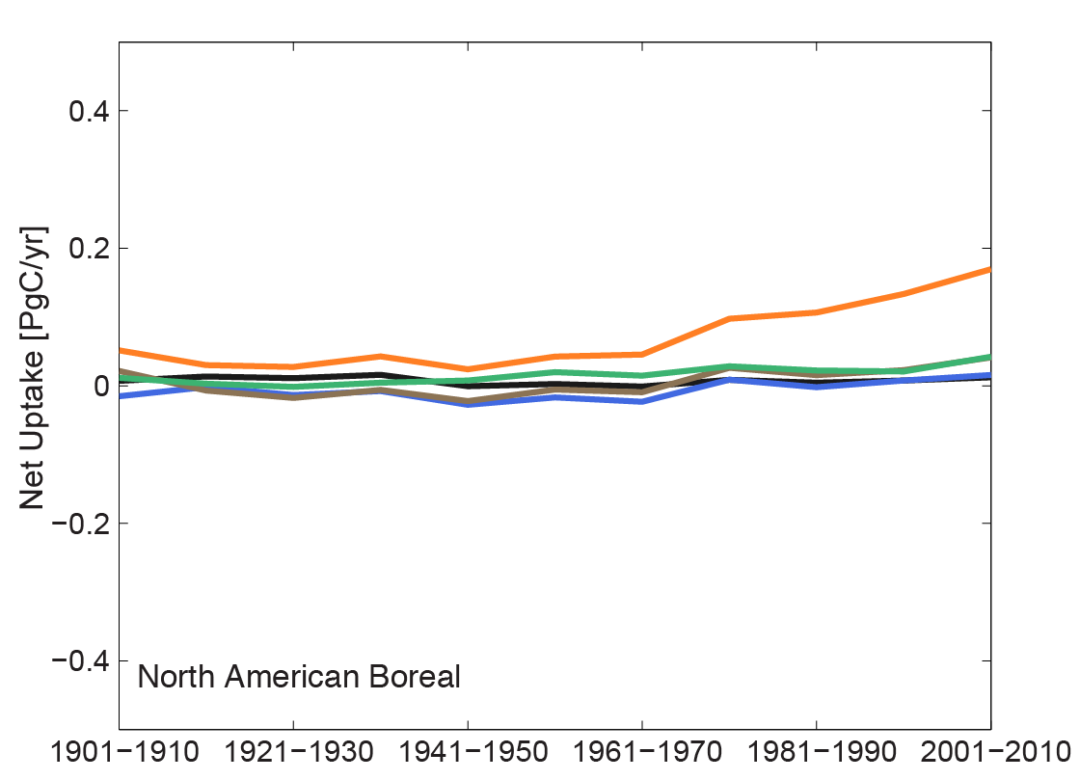
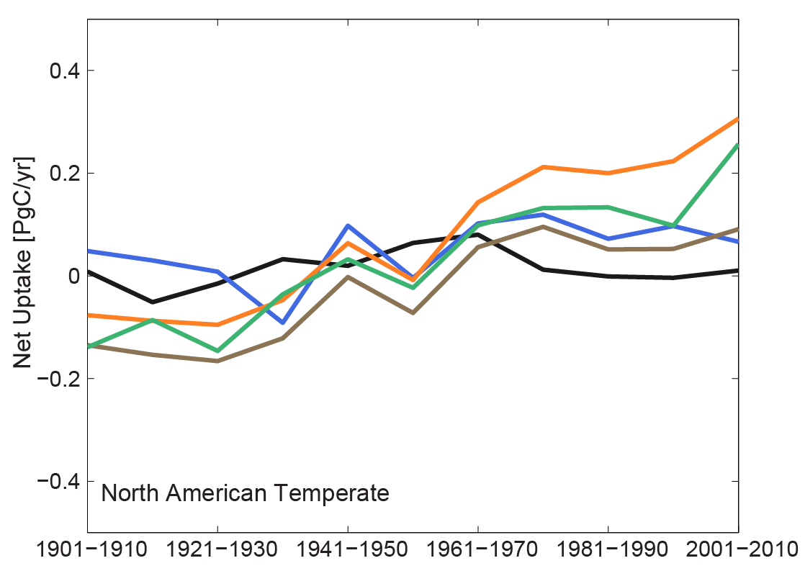
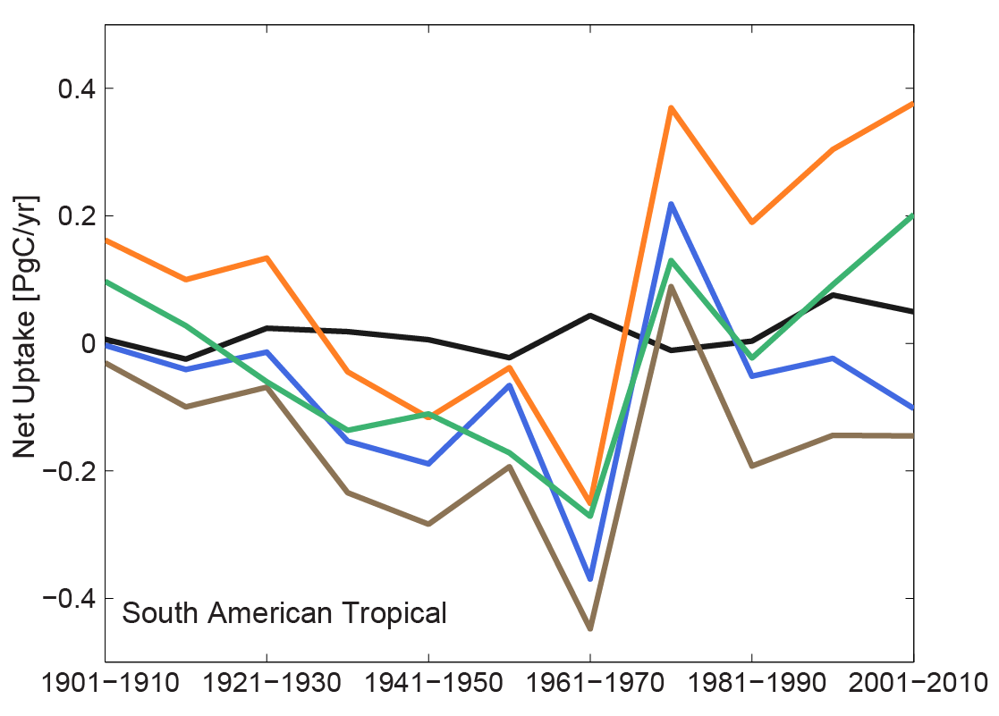
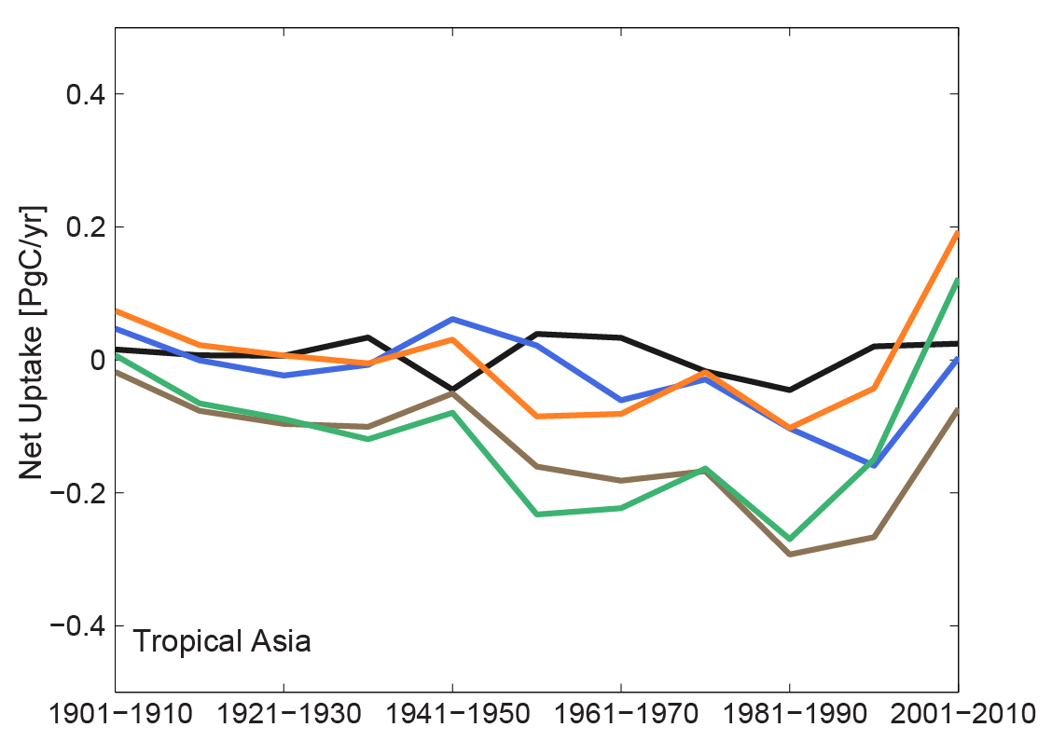
Time-varying drivers:
Notes:
Net land sink by simulation, by region, by decade. Multi-model mean across models. N (number of models) varies per simulation
Interdecadal variability controlled by time-varying climate
Greater spread between simulations (sensitivity to driver data) in mid-latitudes, lower spread (sensitivity) and higher latitudes)
In general, models predict net land sink in Northern Hemisphere and a net carbon loss in southern hemisphere

Slide 14
Sensitivity of net flux to each forcing factor?
Time-varying:
Climate (SG1 - RG1)
Land-use land-cover change (SG2 - SG1)
Atmospheric CO₂ concentrations (SG3 - SG2)
Nitrogen deposition (BG1 - SG3)
Model | RG1 | SG1 | SG2 | SG3 | BG1
Biome-BGC | X | X |  |  | X
CLASS-CTEM-N+ | X
CLM | X | X | X | X | X
CLM4-VIC | X | X | X | X | X
DLEM | X | X | X | X | X
GTEC | X | X | X | X
LPJ-wsl | X | X | X | X
ORCHIDEE-LSCE | X | X | X | X
SiB3-JPL | X
SiB-CASA | X
VEGAS | X | X | X | X
VISIT | X | X | X | X
Model | RG1 | SG1 | SG2 | SG3 | BG1
Biome-BGC | X | X |  |  | X
CLASS-CTEM-N+ | X
CLM | X | X | X | X | X
CLM4-VIC | X | X | X | X | X
DLEM | X | X | X | X | X
GTEC | X | X | X | X
LPJ-wsl | X | X | X | X
ORCHIDEE-LSCE | X | X | X | X
SiB3-JPL | X
SiB-CASA | X
VEGAS | X | X | X | X
VISIT | X | X | X | X
Only those models that have RG1 through SG3/BG1 are included in sensitivity analysis
Notes:
Only those models that submitted RG1-SG3/BG1 are included in sensitivity analysis( (N=7 models, plus the mean across these 7 models).

Slide 15
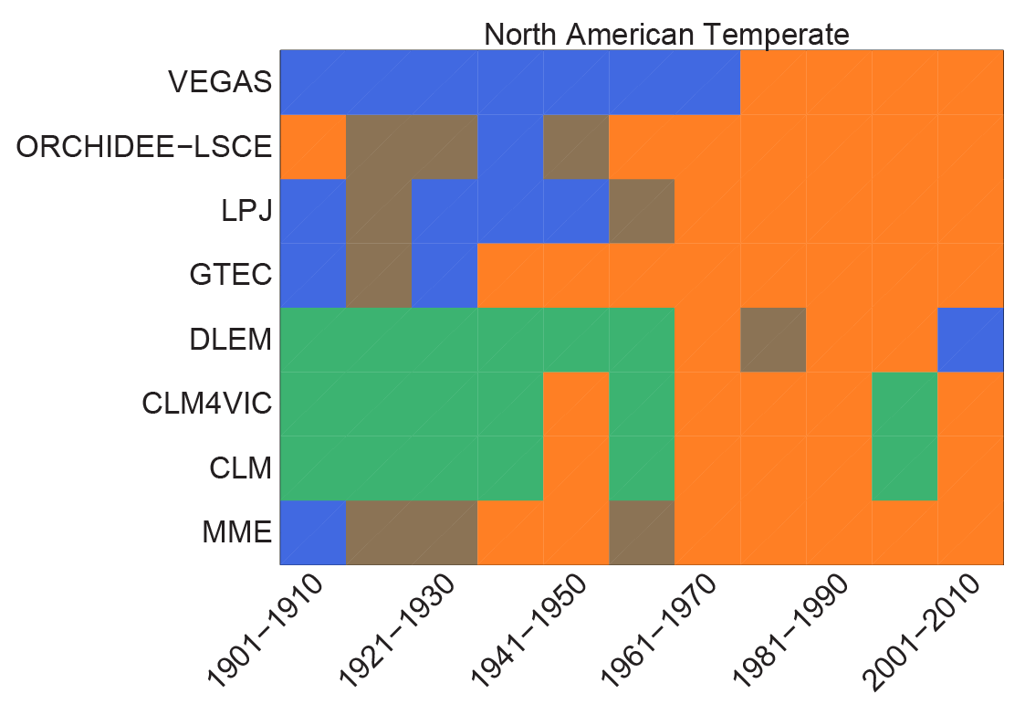
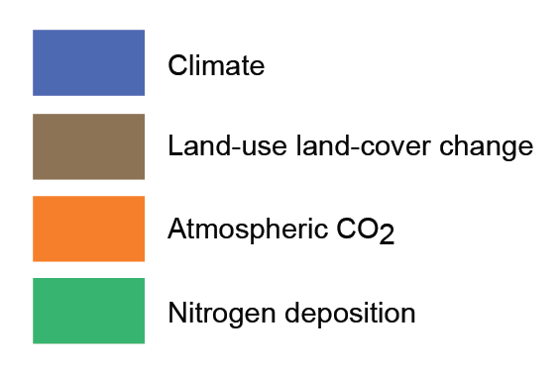
Sensitivity of net flux to each forcing factor
Driver resulting in greatest change (% diff) in net uptake
Net uptake by simulation
Normalized difference between simulations
Only those models that have RG1 through SG3/BG1 included in sensitivity analysis

Slide 16
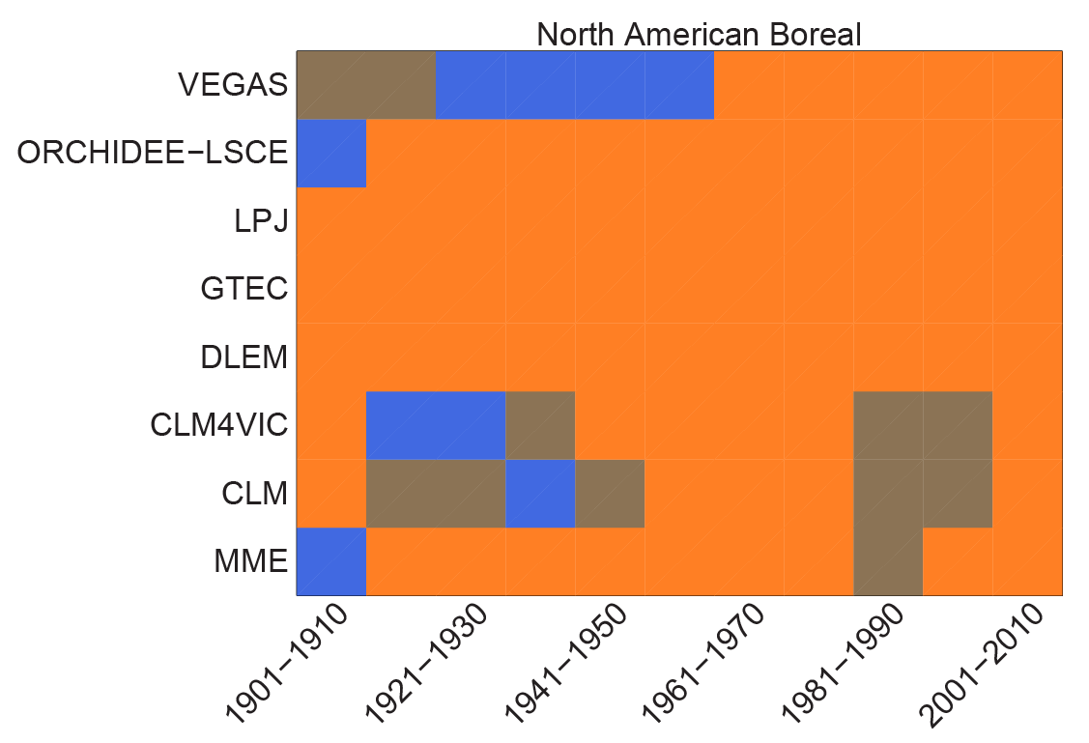
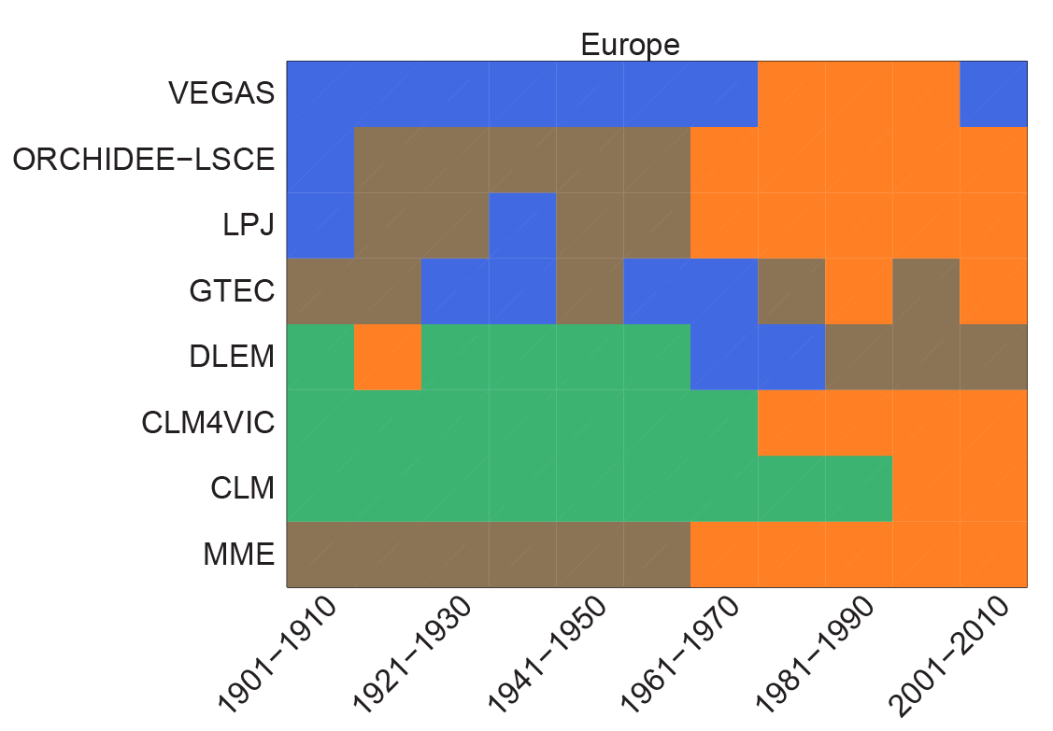
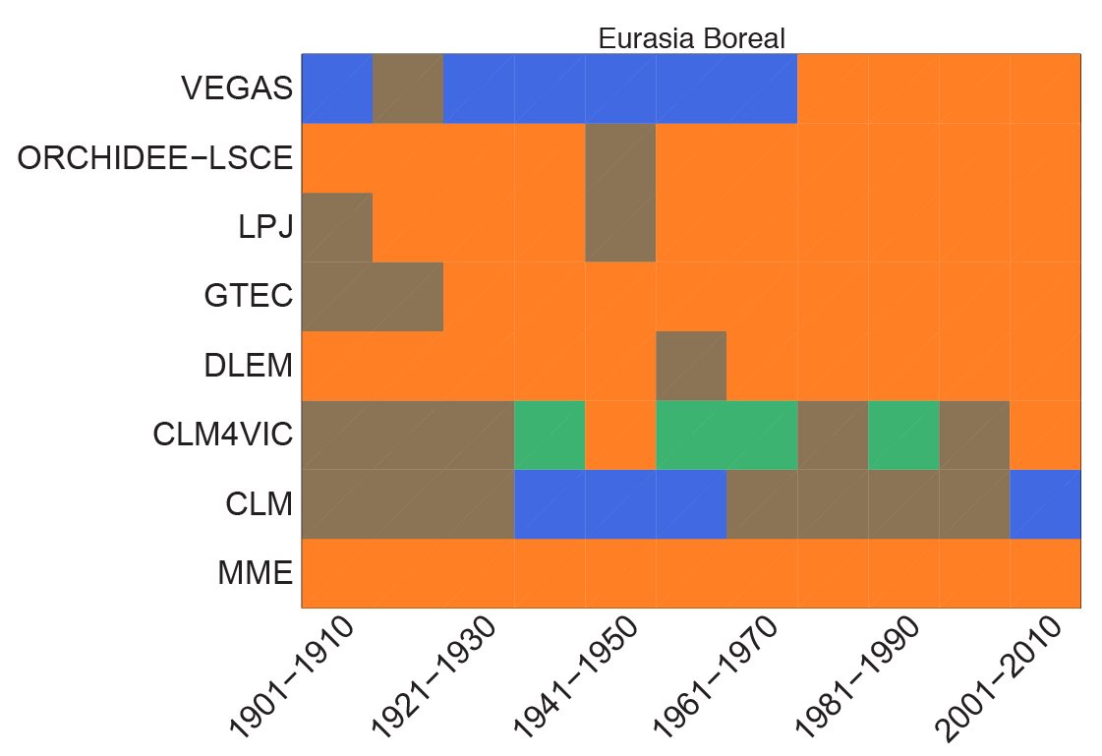
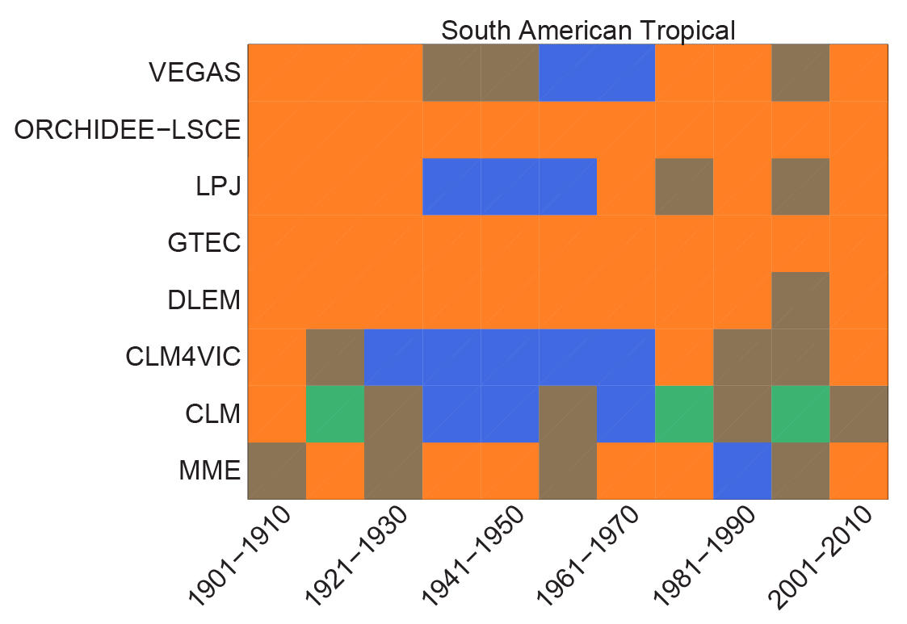
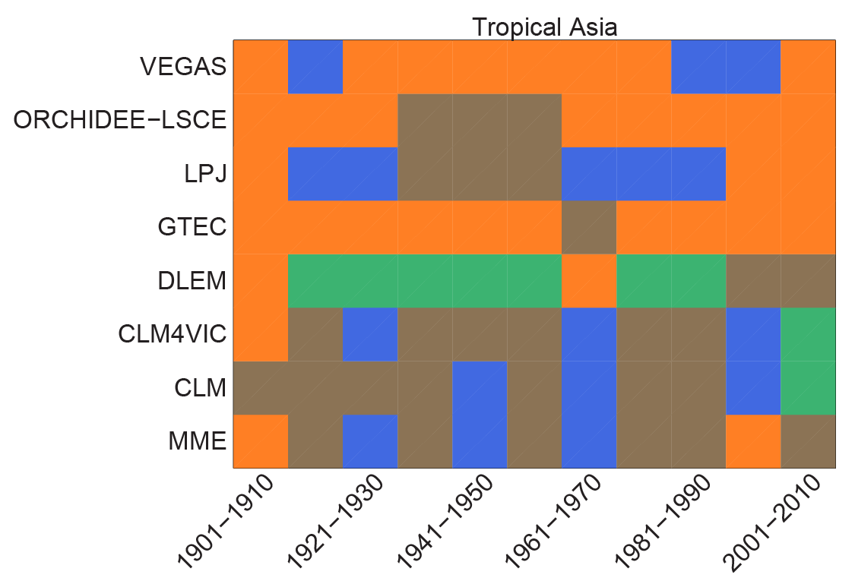
MME across 7 models, RG1-SG3 only
Time-varying drivers:
Notes:
MME mean includes RG1-SG3 only (7 models; not BG1 since number of models changes).
In North America, starting in the 70s, most dominant driver of changes in net land sink appears to be time-varying CO2. See similar trends in Europe.
CO2 fertilization effect (or sensitivity to changes in CO2 appear to be stronger in models without dynamic nitrogen cycles.
Sensitivity to environmental drivers is more variable in tropical regions, particularly among those models that include a dynamic nitrogen cycle.

Slide 17
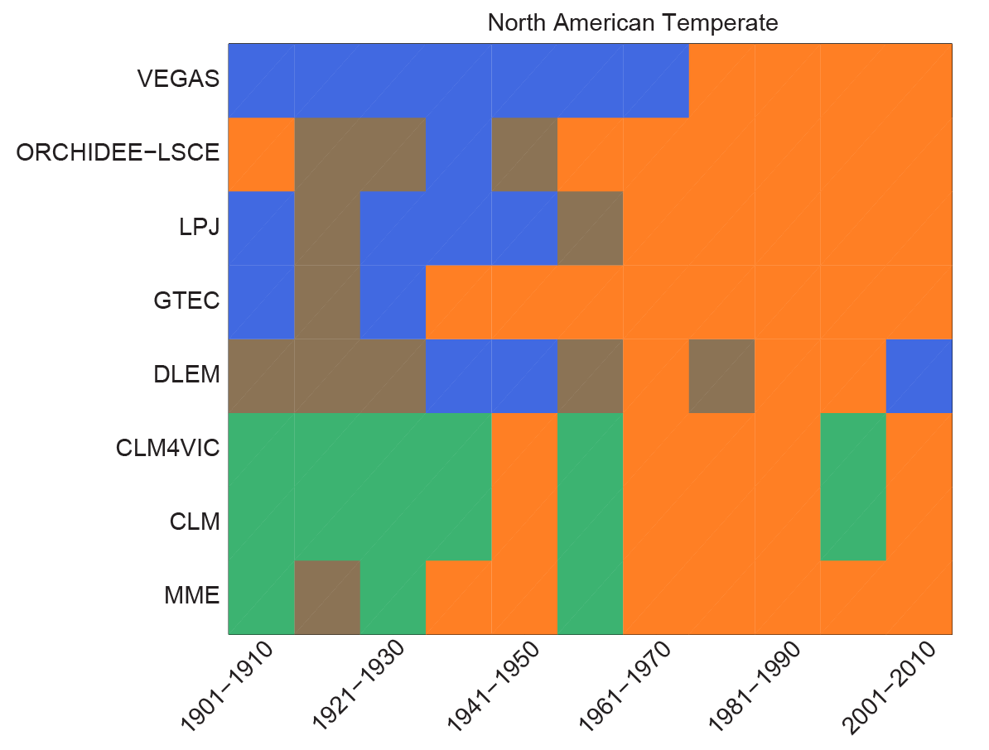
Conclusions
Even with consistent driver data and simulation protocol, there is a large spread in MsTMIP estimate (best estimate) of the global net land sink.
MsTMIP ensemble mean (best estimate) shows a slightly stronger net land sink than the Global Carbon Project (GCP) product.
Estimates of the net land sink appear to be most sensitive to changes in atmospheric CO₂ concentrations, particularly:
In North America and Europe
Post 1970s
In models that do not include a prognostic N-cycle

Slide 18
Questions?
For further info see:
http://nacp.ornl.gov/MsTMIP.shtml
Recent manuscripts on MsTMIP experimental design and driver data:
Huntzinger et al., (in press) The North American Carbon Program Multi-scale synthesis and Terrestrial Model Intercomparison Project – Part 1: Overview and experimental design, Geoscientific Model Development
Wei et al., (in review) The North American Carbon Program Multi-scale Synthesis and Terrestrial Model Intercomparison Project – Part 2: Environmental driver data, Geoscientific Model Development Discussions
MsTMIP related AGU posters & presentations:
B13M-06. 2:55PM - 3:10PM Monday; Ren et al., Evaluating natural and human impacts on carbon balance of global agro-ecosystems during 1901-2010 based on multiple terrestrial models and data.
B22D-07. 11:50 AM - 12:05 PM Tuesday; Tian et al. Global soil organic carbon dynamics as estimated by multi-terrestrial ecosystem models and field observations.
B43F-05. 3:01 PM - 3:16 PM; Thursday; Zscheischler et al., Impact of Large-Scale Climate Extremes on Biospheric Carbon Fluxes: An Intercomparison Based on MsTMIP Data.
Notes:
Adding more info here

