Slide 1
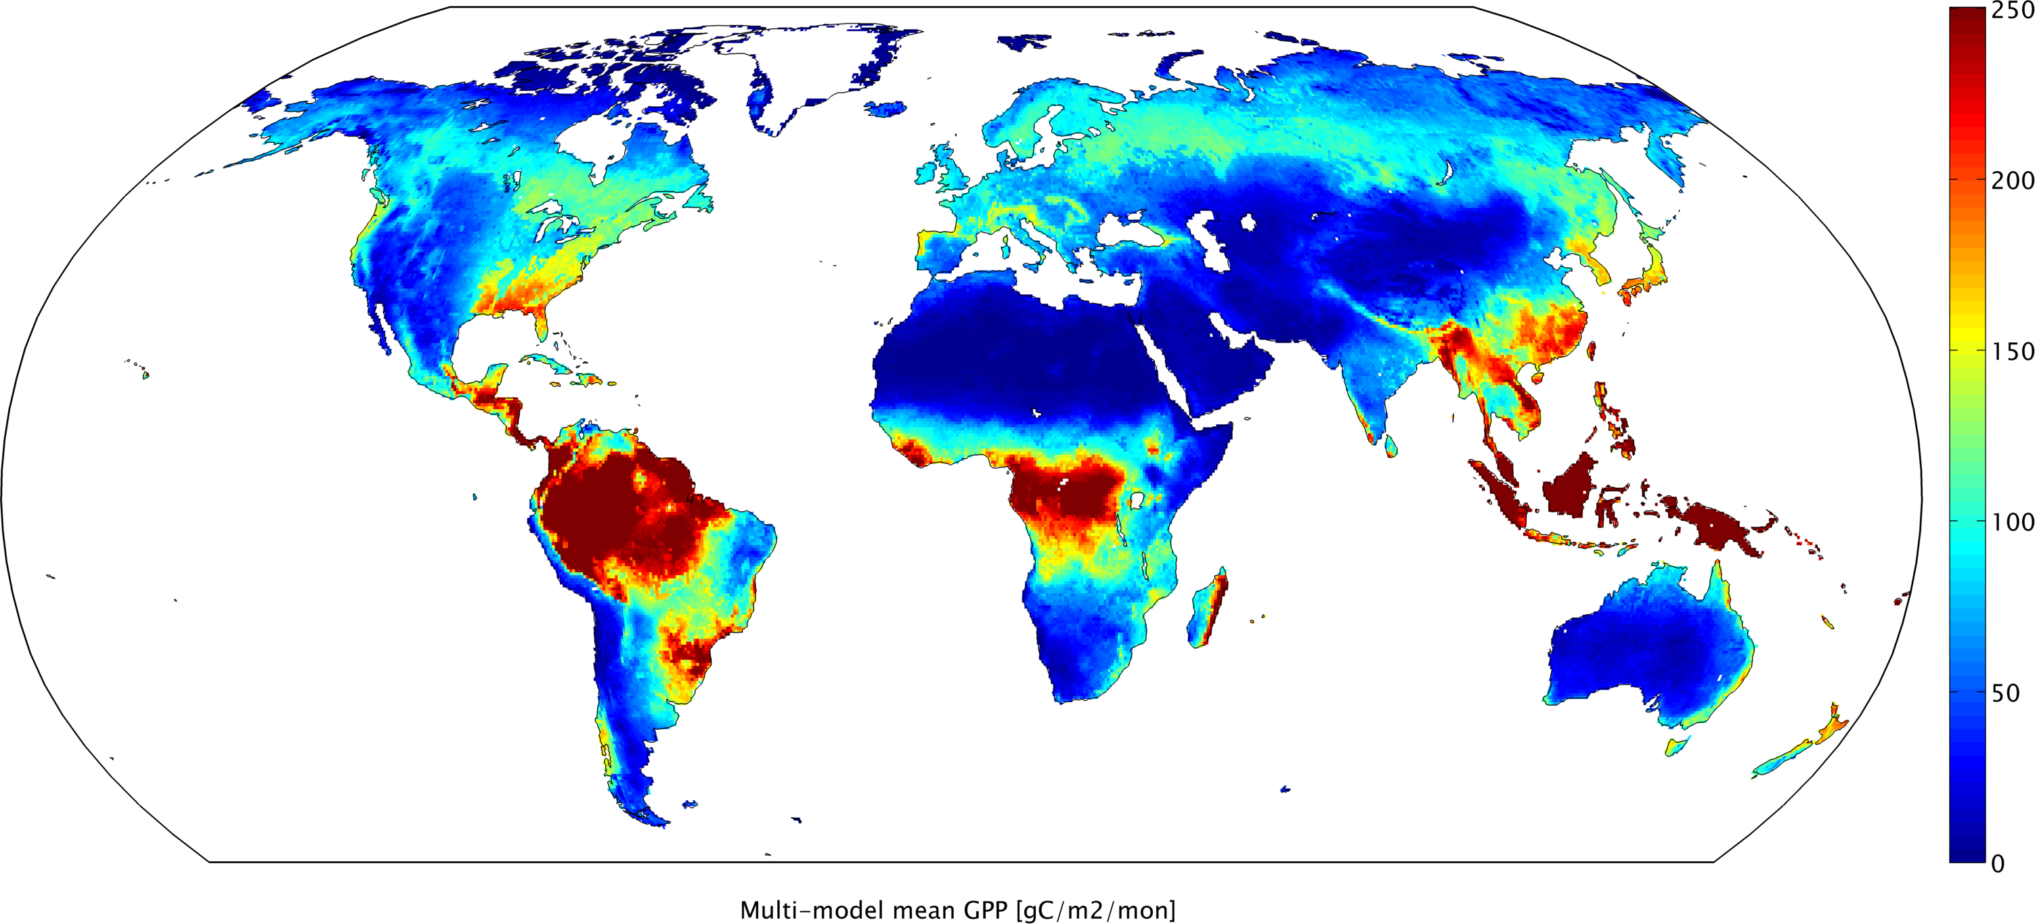
Multi-Scale Synthesis and Terrestrial Model Intercomparison Project – A Systematic Approach for Evaluating Land-Atmosphere Flux Estimates
December 5, 2012
AGU Fall Meeting, San Francisco
Deborah Huntzinger
Northern Arizona University
C. Schwalm, A. Michalak, W. Post, K. Schaefer, A. Jacobson. Y. Wei, R. Cook, & MsTMIP Participants

Slide 2
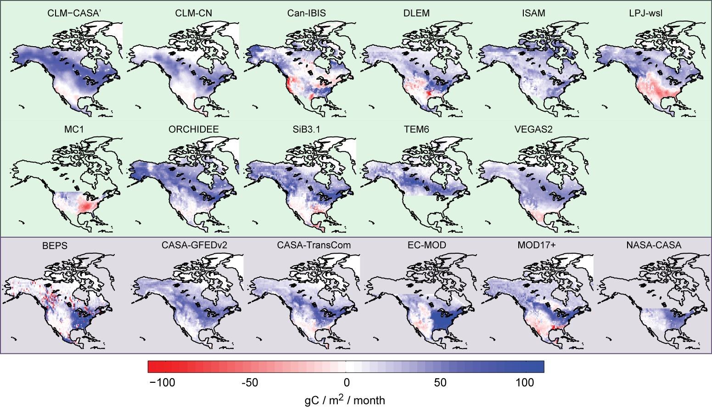
Future projections depend, in part, on ability to model land-atmosphere carbon exchange
Huntzinger et al. (2012) Ecological Modeling
Friedlingstein et al., 2006

Slide 3
Policy and management choices
Understanding of system /
Test hypotheses
Models
Input data
Initial conditions
Parameter values
Assumptions
Process inclusion & formulation

Slide 4
Policy and management choices
Understanding of system /
Test hypotheses
Models
Variability or uncertainty in model estimates driven by:
Environmental driving data
Parameterization (parametric uncertainty)
Model structure (structural uncertainty)
To quantify structural uncertainty need:
Large community of models
Strict simulation protocol
Input data
Initial conditions
Parameter values
Assumptions
Process inclusion & formulation

Slide 5
Multi-scale Synthesis & Terrestrial Model Intercomparison Project (MsTMIP)
Unique in several ways:
Two spatial scales: Global (0.5° by 0.5°); North America (0.25° by 0.25°);
Two distinct sets of standardized environmental input data
Climate, land cover & land-use/land-cover change history, phenology, atmospheric CO₂, nitrogen deposition rates, soil, C3/C4 grass, major crops
Includes over 20 different TBMs
110-year simulation period (1901-2010)
10 different simulations model to assess sensitivity to different forcing factors
Evaluation of model performance against available observations (benchmarking)

Slide 6
Multi-scale Synthesis & Terrestrial Model Intercomparison Project (MsTMIP)
Unique in several ways:
Two spatial scales: Global (0.5° by 0.5°); North America (0.25° by 0.25°);
Two distinct sets of standardized environmental input data
Climate, land cover & land-use/land-cover change history, phenology, atmospheric CO₂, nitrogen deposition rates, soil, C3/C4 grass, major crops
Includes over 8 different TBMs
110-year simulation period (1901-2010)
4 different simulations model to assess sensitivity to different forcing factors
Evaluation of model performance against available observations (benchmarking)

Slide 7
MsTMIP Simulations: Global
Reference simulations → spin-up run out to 2010
Order | Domain | Code | Climate | LULUC | Atm. CO₂ | Nitrogen
1 | Global | RG1 | Constant | Constant | Constant | Constant
2 |  | SG1 | Time-varying (CRU+NCEP)
3 |  | SG2 |  | Time-varying (Hurtt)
4 |  | SG3 |  |  | Time-varying
5 |  | BG1 |  |  |  | Time-varying
Sensitivity simulations → turn one variable component on at a time to systematically test the impact of climate variability, CO₂ fertilization, nitrogen limitation, and land cover / land-use change on carbon exchange.
Baseline simulations → model’s best estimate of net land-atmosphere carbon flux (everything turned on)
Changing land-use, land-cover, CO₂ concentrations, nitrogen deposition rates, etc.
1801
1901
1980
2010
Start with steady-state initial conditions
Start monthly output
Start 3-hourly output
Stop

Slide 8
MsTMIP experimental protocol:
Protocol represents hypotheses that we collectively have:
Strict protocol ➔ isolate impact of model choice on model estimates
Similar structural characteristics ➔ similar estimates of fluxes, carbon pools, etc.
Models will differ in their sensitivity to forcing factors

Slide 9
MsTMIP experimental protocol:
Protocol represents hypotheses that we collectively have:
Strict protocol ➔ isolate impact of model choice on model estimates
Similar structural characteristics ➔ similar estimates of fluxes, carbon pools, etc.
Models will differ in their sensitivity to forcing factors

Slide 10
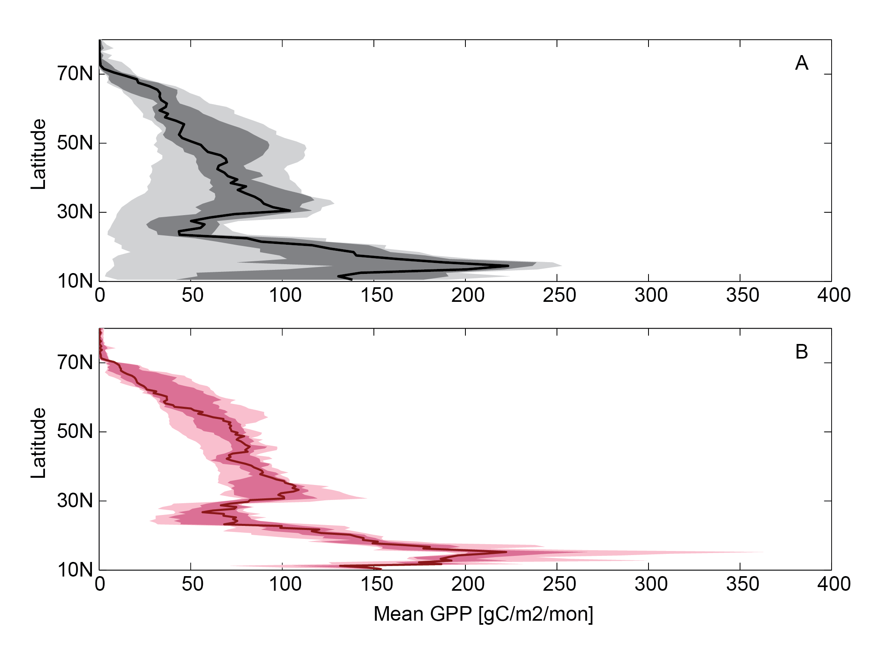
NACP Regional Interim Synthesis vs. MsTMIP Mean GPP for North America (2000-2005)
Range
Interquartile range
NACP regional interim synthesis
Median
“Unconstrained” protocol
MsTMIP
“Constrained” protocol
5 models (CLM, DLEM, LPJ, ORCHIDEE, VEGAS)
Huntzinger et al., (2012) GMD in prep.

Slide 11
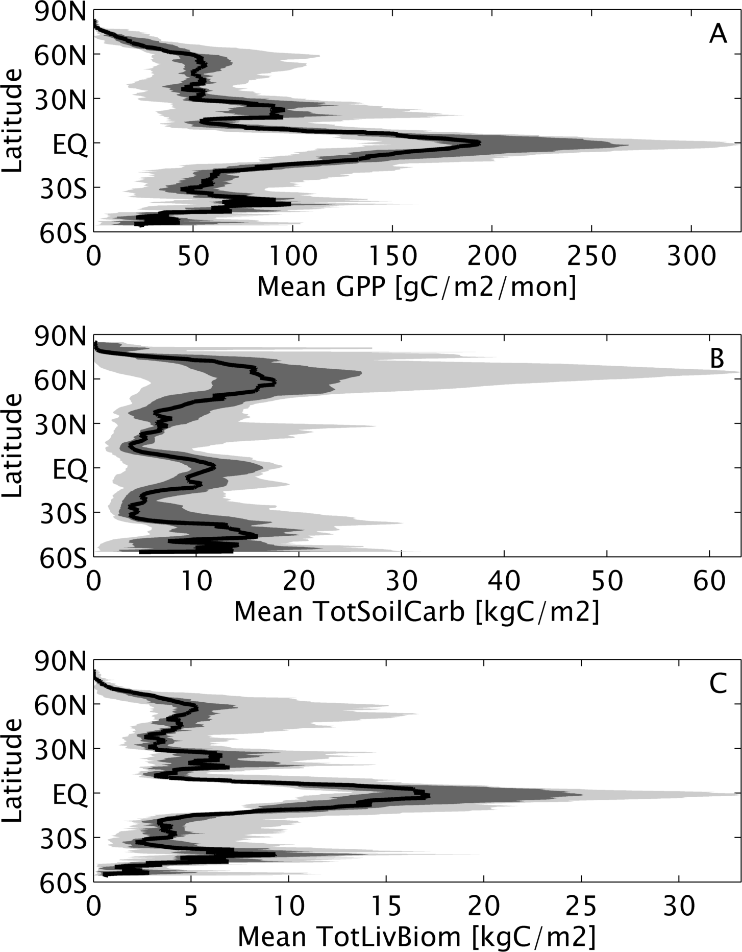
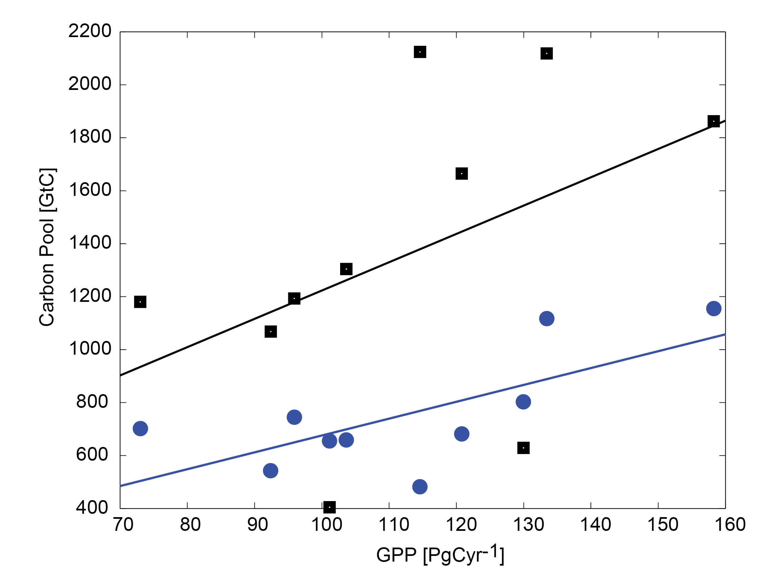
MsTMIP: Steady-State or Initial Conditions
Steady-state GPP, total soil carbon, and total living biomass (10 models)
Influence of model structure and parameterization
Range
Interquartile range
Median
Total living biomass
Soil carbon
Huntzinger et al., (2012) GMD in prep.

Slide 12
MsTMIP experimental protocol:
Protocol represents hypotheses that we collectively have:
Strict protocol ➔ isolate sources of differences
Similar structural characteristics ➔ similar estimates of fluxes, carbon pools, etc.
Sensitivity to forcing factors will differ among models
Need to identify models that share similar characteristics
Track model differences ➔ Detailed model survey

Slide 13
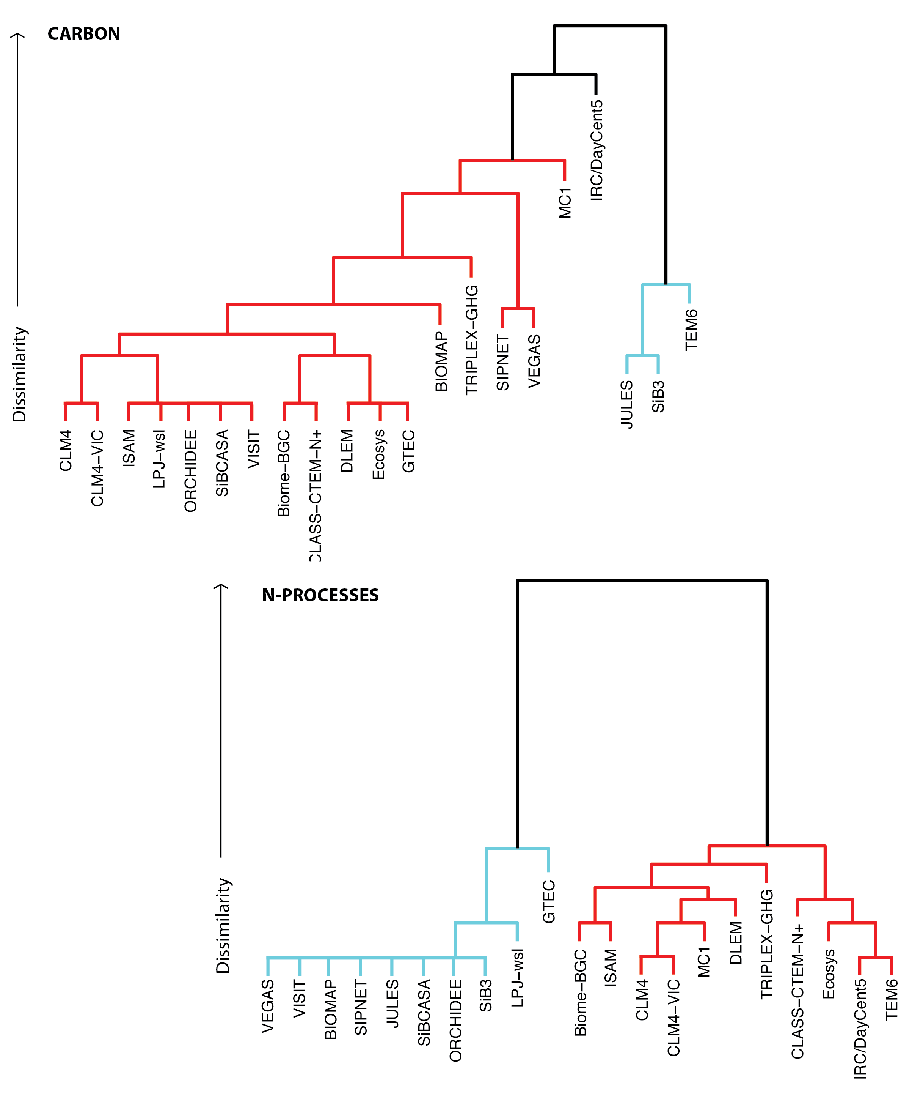
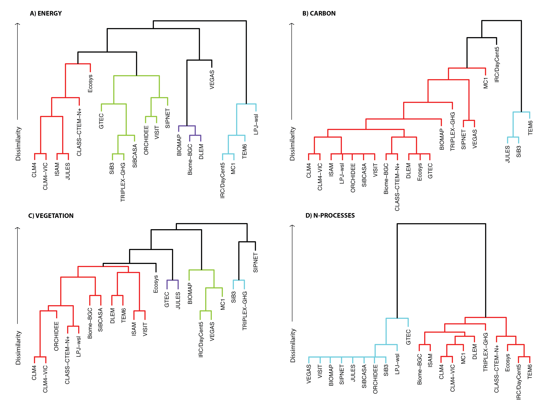
Visualizing model structural differences using dendrograms

Slide 14
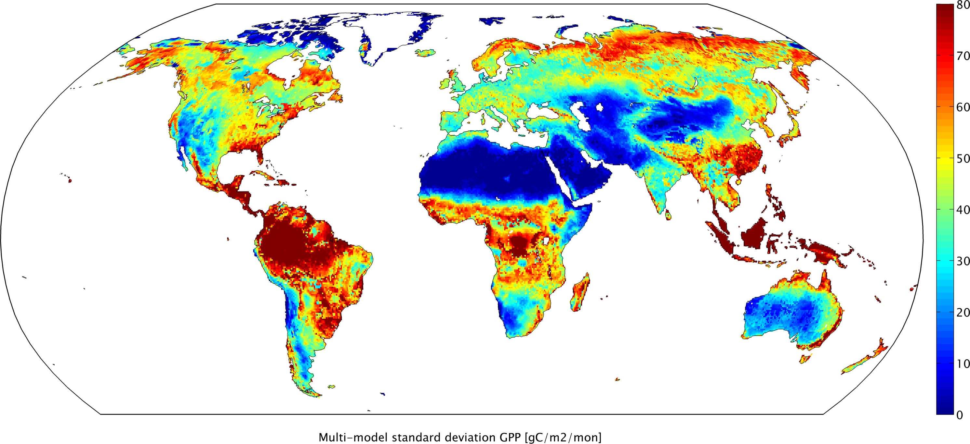
“Best estimate” of gross primary productivity (GPP) (2001-2010)
8 models (BIOME-BGC, CLM, CLM4ViC, DLEM, LPJ, ORCHIDEE, VEGAS, VISIT)

Slide 15
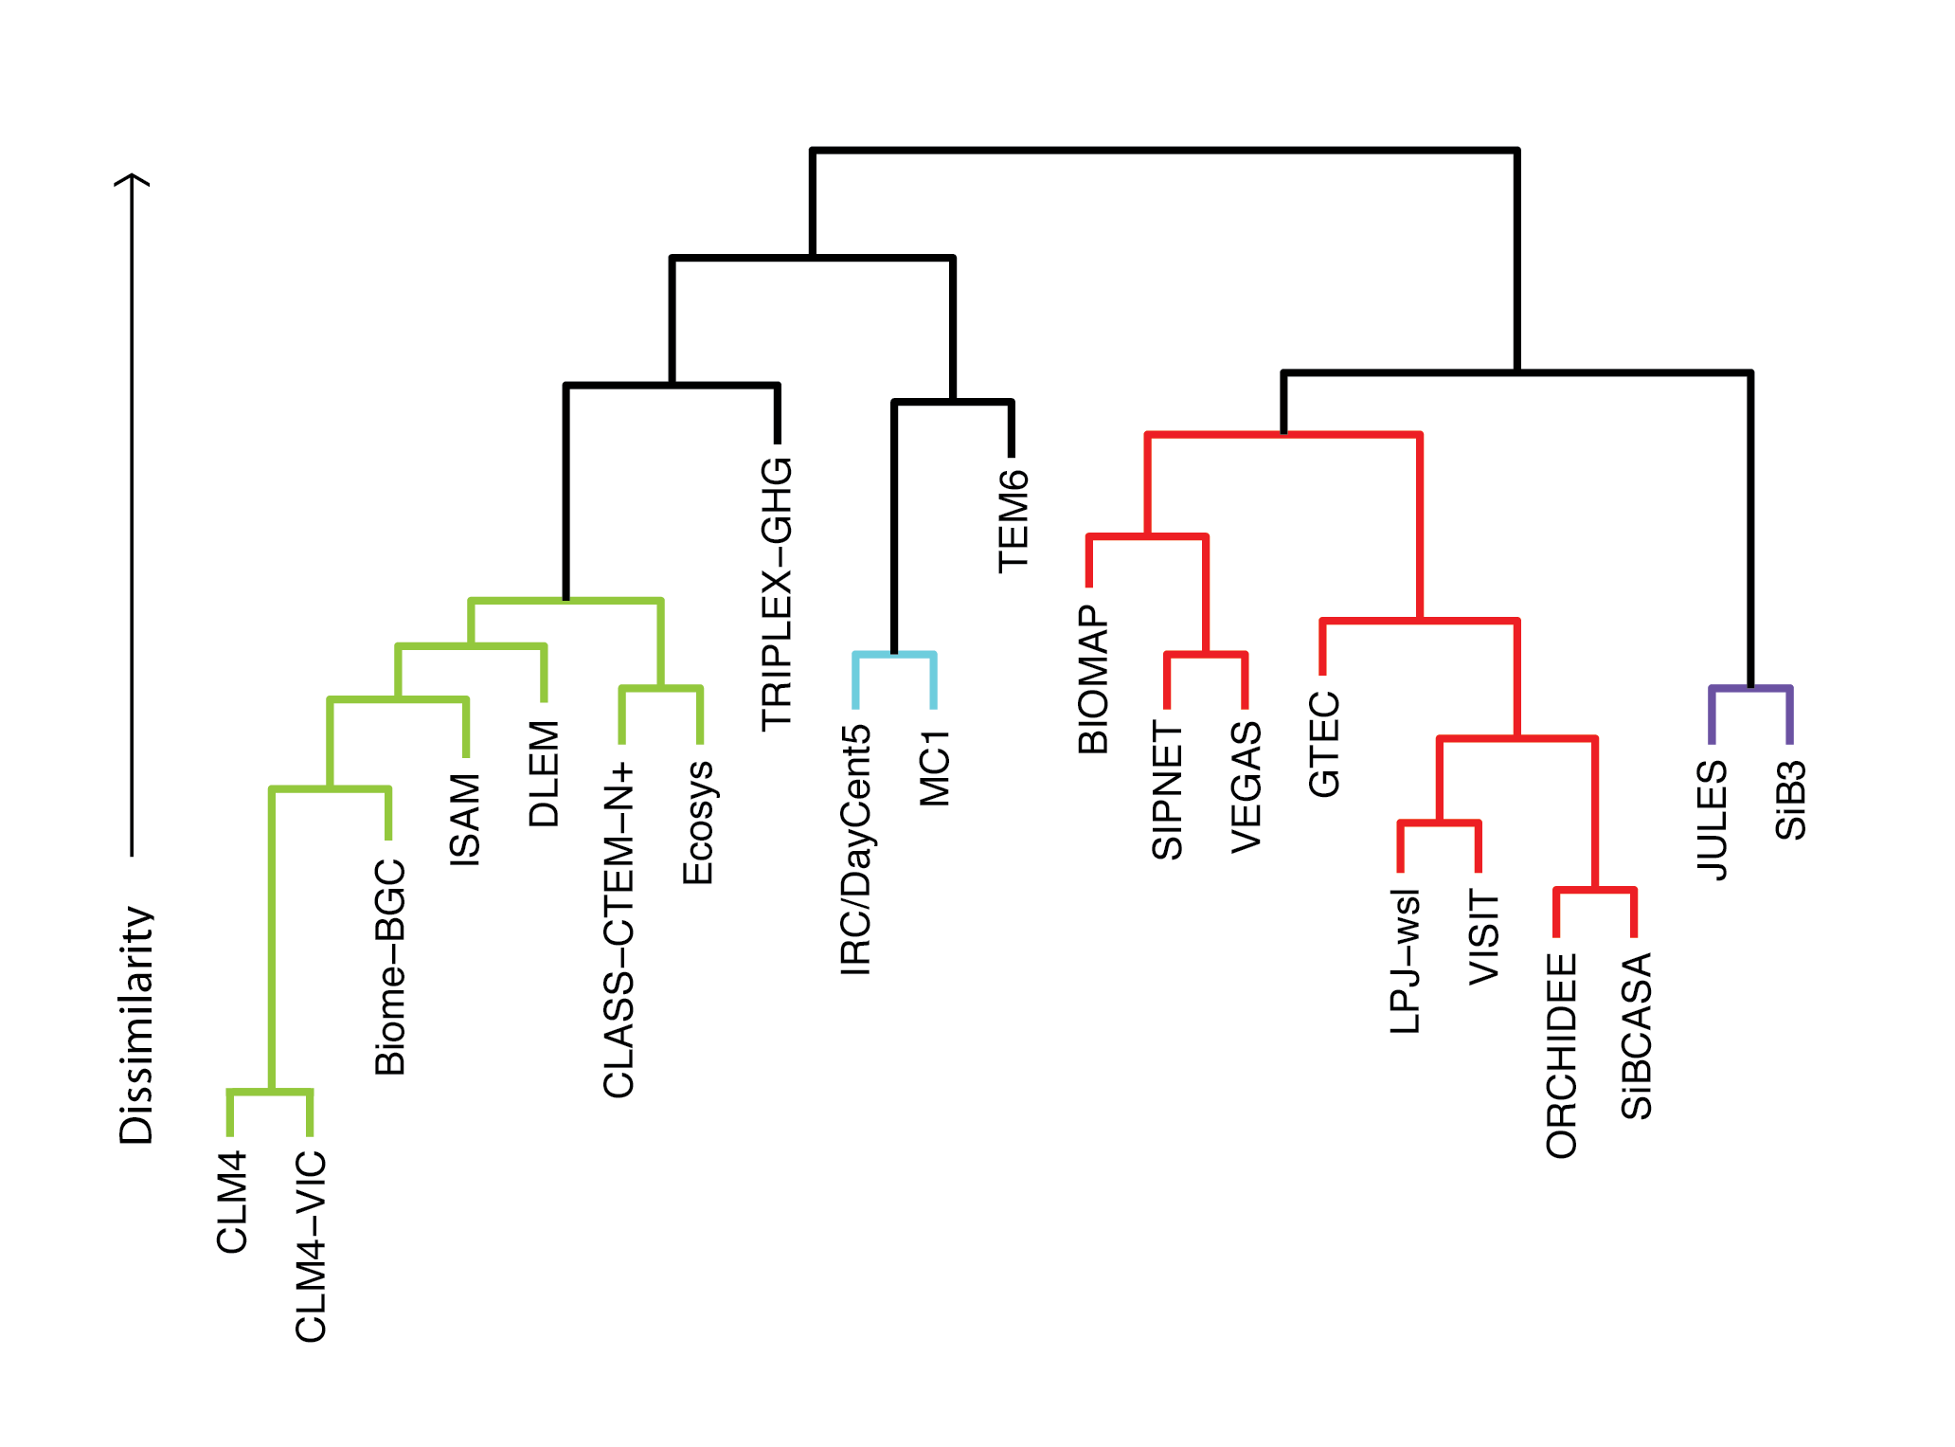
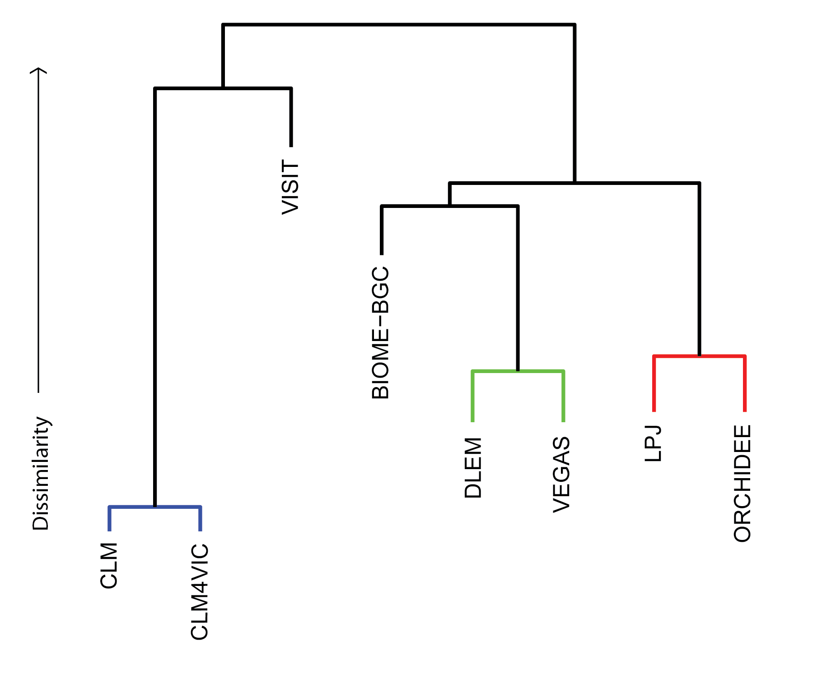
Do models with similar structural characteristics will have similar estimates of GPP?
Globally aggregated net GPP (2001-2010)
Overall model structural differences

Slide 16
MsTMIP experimental protocol:
Protocol represents hypotheses that we collectively have:
Strict protocol ➔ isolate sources of differences
Similar structural characteristics ➔ similar estimates of fluxes, carbon pools, etc.
Sensitivity to forcing factors will differ among models

Slide 17
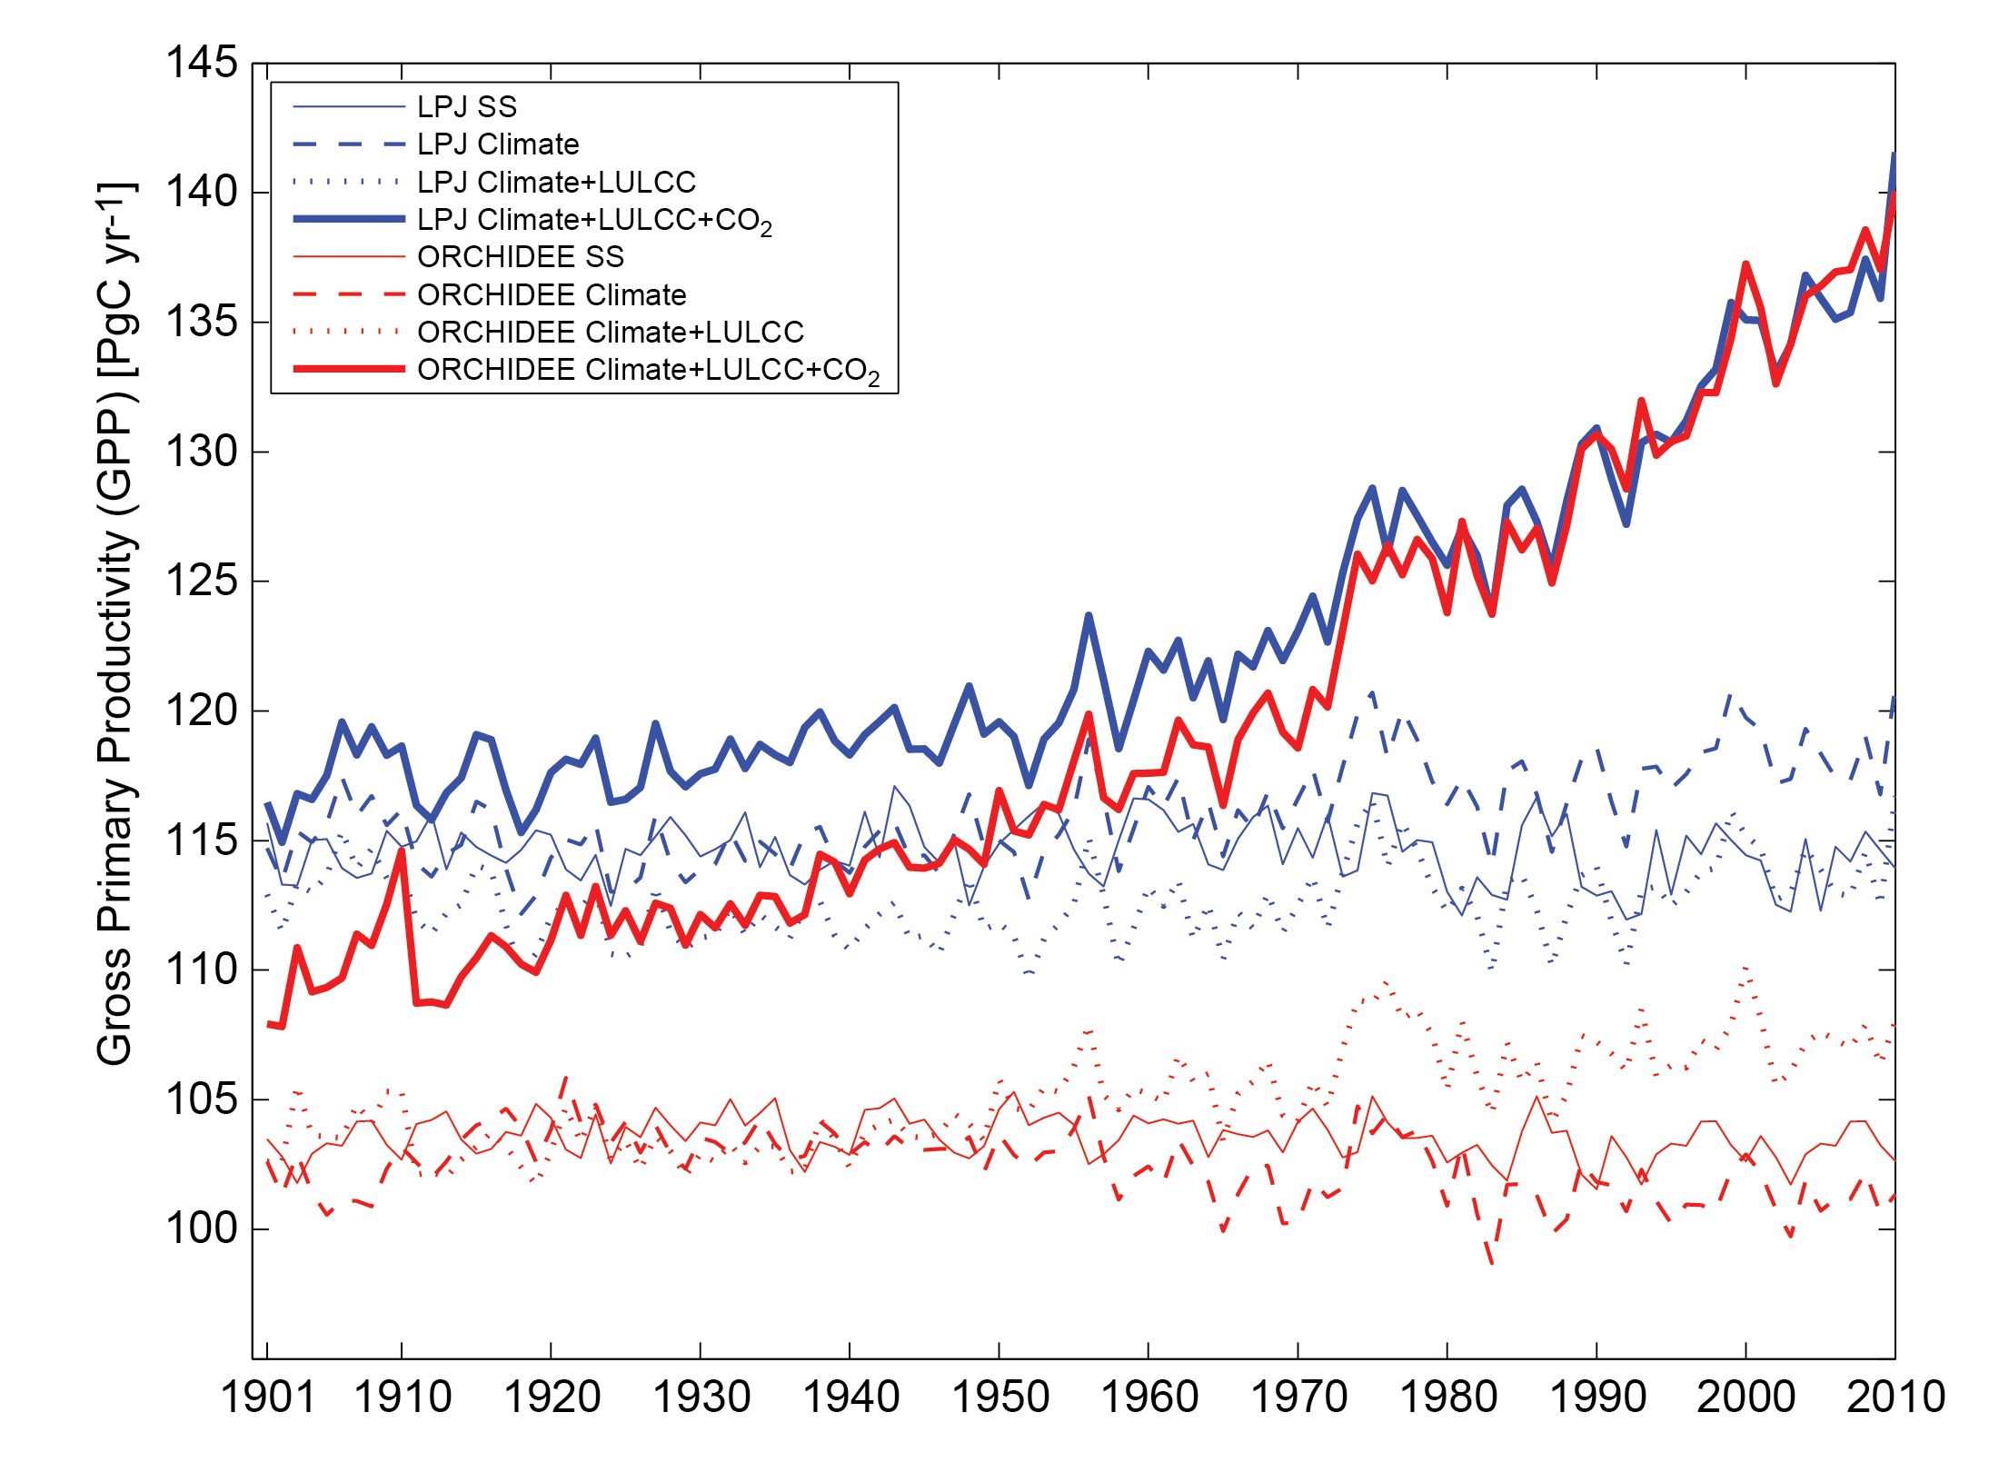
Additive effects of difference forcings:
Gross Primary Productivity (GPP)

Slide 18
Quantifying the additive effects of different forcings over the last decade
 | Net Mean Global Gross Primary Productivity (GPP) [PgC/yr] 2001-2010
Model | Steady-state | Time varying climate (SG1) | Time varying climate & LULCC (SG2) | Time varying Climate & LULCC & CO₂ (SG3)
LPJ | 137 | 141 | 136 | 162
ORCHIDEE | 123 | 117 | 127 | 162
Sensitivity of LPJ and ORCHIDEE to climate and land use / land cover change differs
Both models highly sensitive to time-varying CO₂ concentrations
 | % ΔGPP when adding time varying:
Model | Climate | Land use, land cover change | Atmospheric CO₂
LPJ | 3.2 | -4.1 | 19.7
ORCHIDEE | -4.6 | 8.6 | 27.8

Slide 19
Summary and what’s next
By isolating sources of variability (through strict protocol), we can evaluate model results in a way that was not possible with the NACP regional synthesis activity:
Attribute inter-model variability to structural differences
Quantify sensitivity of models (and their estimates) to forcing factors
Model-data evaluation (benchmarking) is currently underway; will evaluate model performance as a function of:
Domain (global versus North America)
Spatial and temporal resolution of driver data
MsTMIP Workshop following NACP AIM4, February, 2013, Albuquerque, NM.

